Slide 1
EFCL Workshop A RISC-V Vector-Processor for High-Throughput Multidimensional Sensor Data Processing
17.08.2023
Matteo Perotti mperotti@iis.ee.ethz.ch

Slide 2
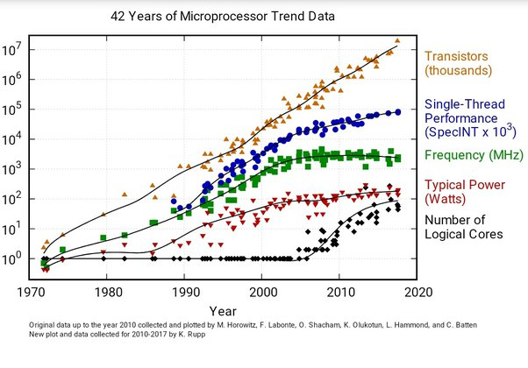
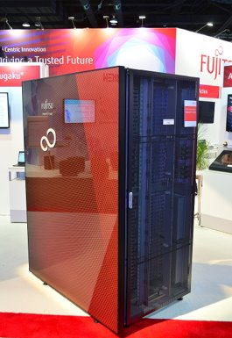
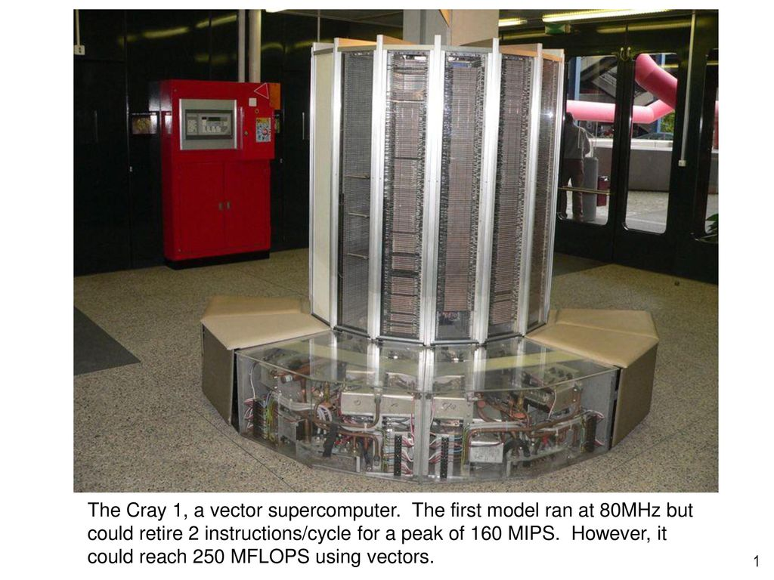
The curious case of Vector Processors
Cray X1
256 MFLOPS
Fastest supercomputer in 1976!
SUPERCOMPUTER FUGAKU
500 PFLOPS
Second fastest supercomputer in 2023!
Inexpensive silicon
ILP, OoO, Super Scalar
Hype for Vector Processors
End of Dennard’s Scaling
Power wall

Slide 3
Single-Instruction, Multiple-Data (SIMD) processor
SCALAR CORE
One instruction – One Operation
BW and Power on the I-MEM
RF size is usually fixed
One data element per entry
Too small for highly-intensive WL
BW and Power on the D-MEM
SIMD CORE
One instruction – Multiple operations
Lower BW and Power on the I-MEM
RF size is larger
Multiple data elements per entry
Better buffering, exploit locality
Lower BW and Power on the D-MEM
Scalar
D MEM
SIMD
D MEM
RF
RF
I MEM
I MEM
1 ADD
N ADD
ADD
ADD

Slide 4
Vector Processors – A flexible and efficient choice
SIMD CORE
Vector Length (VL) encoded in the instruction!
Support new VL? Extend the ISA!
e.g., add128, add256, ...
RF is not flexible
VECTOR CORE
Programmable VL
VRF size decoupled from DP width
SIMD
D MEM
VEC
D MEM
RF
VRF
I MEM
I MEM
N ADD
N ADD
ADD
ADD

Slide 5
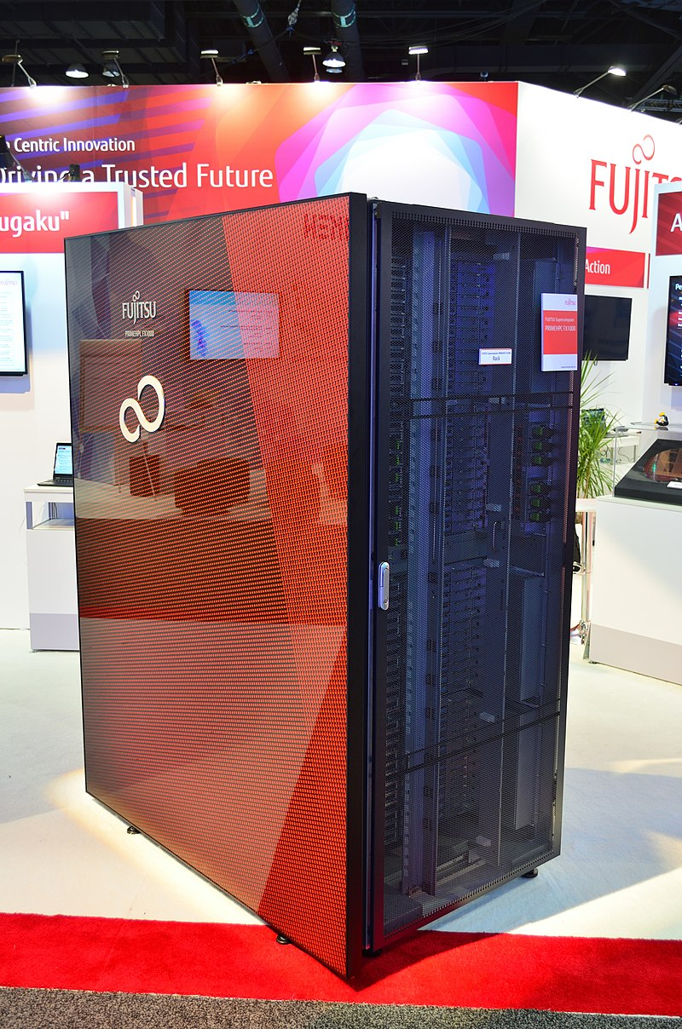
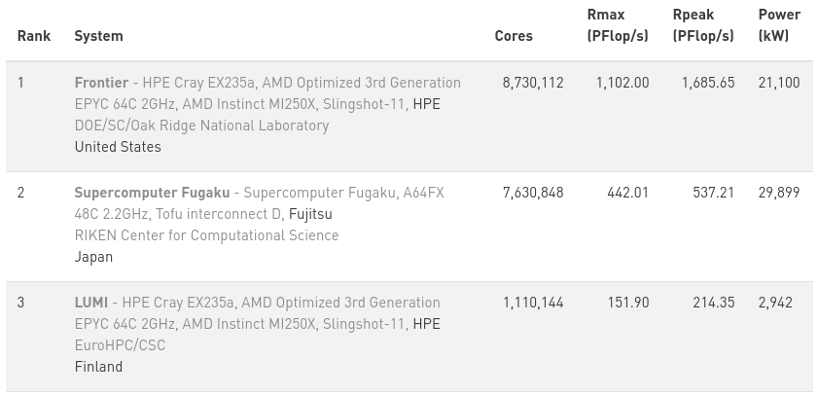
Only Fugaku?
Intel
From SSE to AVX
Arm
From NEON to SVE (powering FUGAKU), SVE2, Helium
RISC-V
V extension
[1] Fugaku supercomputer at SC19. FUJITSU Supercomputer PRIMEHPC FX1000 Rack Raysonho @ Open Grid Scheduler / Scalable Grid Engine - Eigenes Werk CC BY-SA 4.0

Slide 6
RISC-V V ISA - A long journey
2015
Early draft in 2015
Years of refinment. Frozen in end 2021.
Known programming model
RVV 0.5 proposal
Ara prototype
RVV 0.6
RISC-V²
Comprehensive ISA (+300 instructions)
VRF setup instructions (VL, element width, ...)
Arithmetic instructions (int, fixpt, fp)
Memory operations (unit-stride, strided, indexed)
Predicated execution (masks)
Permutation instructions (slide, reorder) Vector length agnostic – High reusability!
RVV 0.7
RVV 0.8
RVV 0.9
Xuantie 910
Vitruvius
Arrow
RVV 1.0 frozen
Vicuna
AndesNX27V
SiFive X280
2021

Slide 7
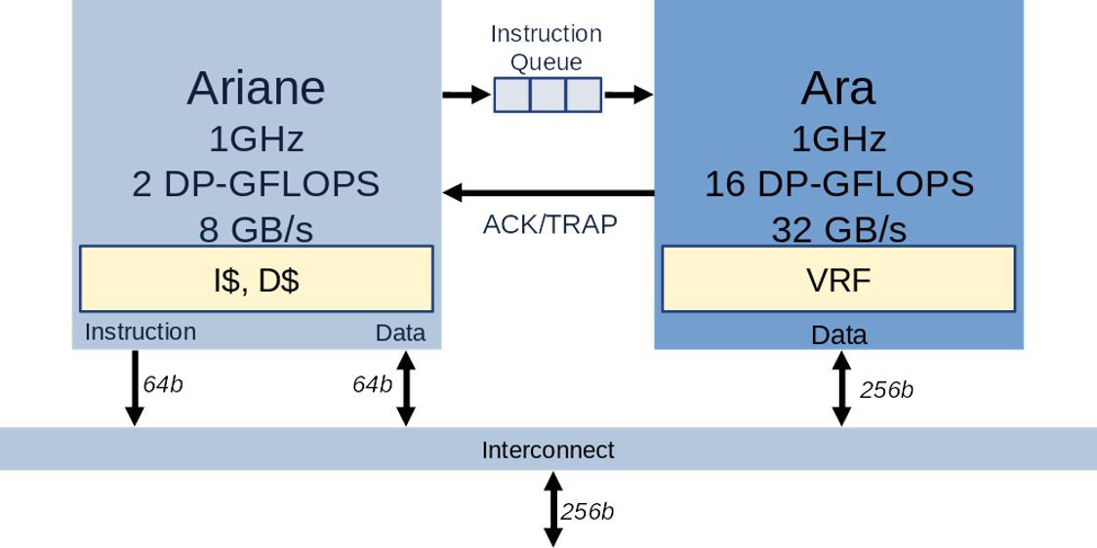
EFCL Project Overview
Duration - 24 months
Start: 03/21
End: 03/23
Starting point
AraV1 (RISC-V V draft v0.5)
Peak performance/efficiency on matmul and conv2d for long vectors
Goals
Expand benchmark pool with heterogeneous applications for high-dimensional workloads
Update Ara from RISC-V V v0.5 to the most recent RISC-V Vector ISA (v0.9)
Develop uArchitecture to improve IPC, Performance, Energy Efficiency
Address coherence problem between Ara and Ariane
HW/SW interface mixing intrinsics, hand-optimized macros, vector compilation

Slide 8
EFCL Project Timeline, WPs, Milestones
Year 1
WP1: Workload analysis and benchmarking Select and implement key application kernels
WP2: uArch design and exploration of instruction extensions Develop the new micro-architecture compliant with RVV 0.9 (then RVV 1.0) Evaluate HW cost of ISA extensions to speed up key application kernels
Milestones: workload and benchmark analysis, version 0.1 of Ara2 with performance profiling
Year 2
WP3: uArch opt and implementation Optimize and implement microarchitecture Target frequency in the GHz range Emphasize scalability and high energy efficiency PPA of the resulting design
WP4: design space exploration, sw environment, open-source release Verify the design Provide Software support Open-source release of HW and SW
Milestones: version 1.0 of Arav2 with instruction extensions and PPA analysis, open source release of HW and SW

Slide 9
EFCL Project Execution
Bi-weekly meetings
Rationale for SW selection
Discussed with companies, as representative of the target computation
Not too complex to ease vectorization, analysis, and insights
From RiVEC RVV benchmark suite too, to have comparable results
Stress different datapath units of Ara
Project WPs were mainly overlapped:
Specs update (to 0.9, then to 1.0) and new features require iterations on the physical implementation
Benchmarks required HW fixes and modifications, which require new iterations on the implementation
Verification done throughout the project, when adding new instructions, new benchmarks
The software ecosystem evolved throughout the project (compilers, simulator, V intrinsics, ...)
Updates needed to guarantee a high-quality open-source distribution

Slide 10
RISC-V V ISA - A long journey
2015
Early draft in 2015
Years of refinment. Frozen in end 2021.
Known programming model
RVV 0.5 proposal
Ara prototype
RVV 0.6
RISC-V²
Comprehensive ISA (+300 instructions)
VRF setup instructions (VL, element width, ...)
Arithmetic instructions (int, fixpt, fp)
Memory operations (unit-stride, strided, indexed)
Predicated execution (masks)
Permutation instructions (slide, reorder) Vector length agnostic – High reusability!
RVV 0.7
RVV 0.8
RVV 0.9
Ara RVV 0.9 Open-Source
Xuantie 910
Vitruvius
Arrow
RVV 1.0 frozen
Ara RVV 1.0
Vicuna
AndesNX27V
SiFive X280
2021

Slide 11
Ara System – High-Level View
V-INSN
CVA6
Ara 1GHz 2 * #L DP-GFLOPS
4 * #L GB/s
4B * #L
4B * #L

Slide 12
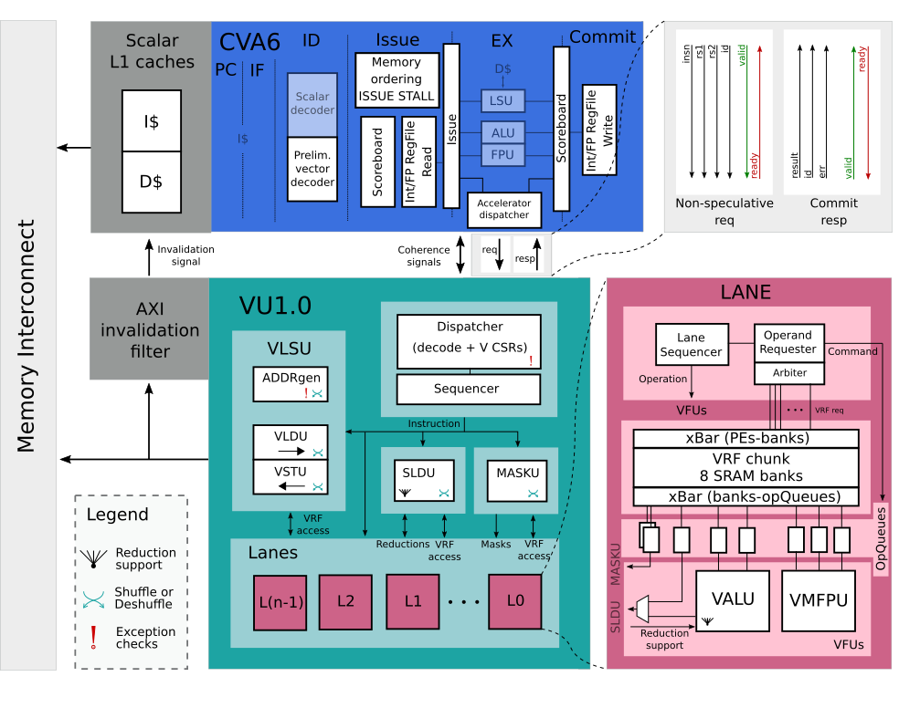
Ara System – One step below
Scalar core: CVA6

Slide 13
Ara System – One step below
Scalar core: CVA6
Vector core: Ara

Slide 14
Ara System – One step below
Scalar core: CVA6
Vector core: Ara
Same AXI interconnect

Slide 15
Ara System – One step below
Scalar core: CVA6
Vector core: Ara
Same AXI interconnect
Parametric number of Lanes
Each lane contains:
FPU, ALU (computation)
Chunk of the VRF (buffering)

Slide 16
Ara System – One step below
Scalar core: CVA6
Vector core: Ara
Same AXI interconnect
Parametric number of Lanes
Each lane contains:
FPU, ALU (computation)
Chunk of the VRF (buffering)

Slide 17
Ara System – The Lane
Computational heart
One 64-bit SIMD FPU/lane
One 64-bit SIMD ALU/lane
Keep a chunk of the VRF
Maximize locality
Element 0 remains in lane 0
Minimize inter-lane communication
VRF in-lane reads/writes
16 Lanes: 32 DP-FLOP/Cycle – 128 HP-FLOP/Cycle!

Slide 18
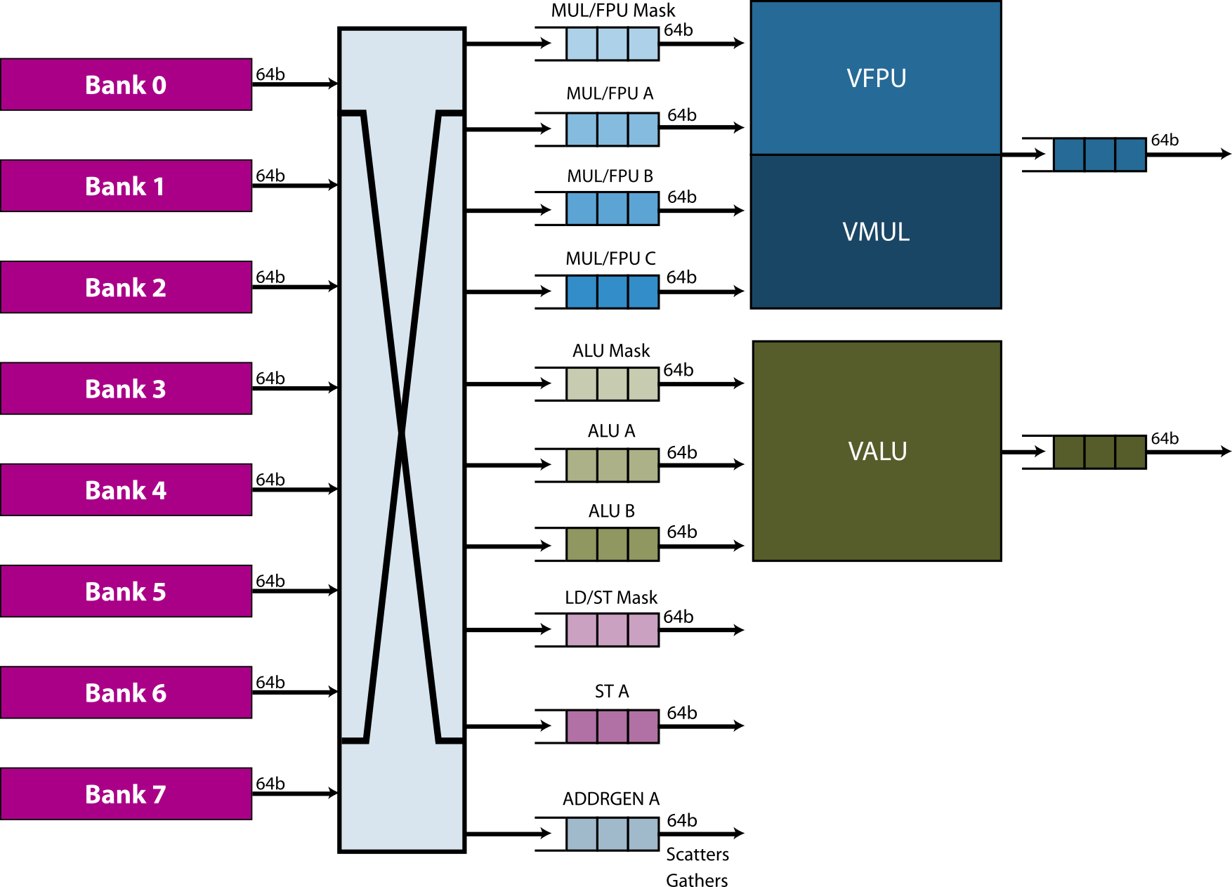
Ara System - The Lane
Modular VRF
4 KiB/lane
8 SRAM banks/lane
Operand queues
Amortize VRF bank conflicts
VRF Chunk (4 KiB)

Slide 19
Ara System – One step below
Scalar core: CVA6
Vector core: Ara
Same AXI interconnect
Parametric number of Lanes
Each lane contains:
FPU, ALU (computation)
Chunk of the VRF (buffering)

Slide 20
Ara System – One step below
Scalar core: CVA6
Vector core: Ara
Same AXI interconnect
Parametric number of Lanes
Each lane contains:
FPU, ALU (computation)
Chunk of the VRF (buffering)
Memory coherence

Slide 21
Ara System – One step below
Scalar core: CVA6
Vector core: Ara
Same AXI interconnect
Parametric number of Lanes
Each lane contains:
FPU, ALU (computation)
Chunk of the VRF (buffering)
Memory coherence
Non-speculative interface

Slide 22
Ara System – Working principles
CVA6 and Ara work in tandem!
CVA6 fetches scalar and vector instructions from memory
Scalar Instruction
Vector Instruction

Slide 23
Ara System – Scalar instructions
Scalar Instruction

Slide 24
Ara System – Scalar instructions
Scalar execution – CVA6
Scalar Instruction

Slide 25
Ara System – Vector instructions
Vector Instruction

Slide 26
Ara System – Vector instructions
Vector instruction dispatch
Vector Instruction

Slide 27
Ara System – Vector instructions
Vector instruction dispatch
Top of the scoreboard
Non speculative!
Vector Instruction

Slide 28
Ara System – Vector instructions
Vector instruction dispatch
Top of the scoreboard
Non speculative!
Ara answers back
Vector Instruction

Slide 29
Ara System – Vector instructions
Vector instruction dispatch
Top of the scoreboard
Non speculative!
Ara answers back
No exceptions? CVA6 commits
Vector Instruction

Slide 30
Ara System – Vector instructions
Vector instruction dispatch
Top of the scoreboard
Non speculative!
Ara answers back
No exceptions? CVA6 commits
Ara executes the instruction
Scalar Instruction
Vector Instruction

Slide 31
Ara
Dispatcher (decode + CSRs)
Sequencer (issue + hazards)
Private VLSU (vload + vstore)
Slide Unit (permutations)
Mask Unit (predication)

Slide 32
Ara
Dispatcher (decode + CSRs)
Sequencer (issue + hazards)
Private VLSU (vload + vstore)
Slide Unit (permutations)
Mask Unit (predication)
Lanes (computation + VRF)
Parametric number of lanes!
From 2 to 16

Slide 33
Ara VRF
Ara 4 Lanes VRF
Size: 16 KiB
Split among the lanes!
L3
L2
L1
L0
v0
32 vregs
.
.
.
.
.
.
.
.
.
.
.
.
v31
128B
128B
128B
128B

Slide 34
VRF – Monolithic vs. Split
#B memory banks
#M masters
#S slaves #L lanes
Lane1
+
m1
mM
xbar
Lane1
LaneL
b1
m1
mM
xbar
xbar
xbar
bB
VRF
b1
bB
xbar
VRF chunk
VRF chunk
VRF chunk
s1
sS
xbar
xbar
xbar
s1
sS

Slide 35
Ara VRF
Vector with 8 elements
2 Byte/element

Slide 36
Ara VRF
Memory (outside Ara)
Vector with 8 elements
2 Byte/element
B15
B14
B13
B12
B11
B10
B9
B8
B7
B6
B5
B4
B3
B2
B1
B0
H1
H0
G1
G0
F1
F0
E1
E0
D1
D0
C1
C0
B1
B0
A1
A0

Slide 37
Ara VRF
Memory (outside Ara)
Vector with 8 elements
2 Byte/element
B15
B14
B13
B12
B11
B10
B9
B8
B7
B6
B5
B4
B3
B2
B1
B0
H1
H0
G1
G0
F1
F0
E1
E0
D1
D0
C1
C0
B1
B0
A1
A0
…
vld v0, (Memory)
…

Slide 38
Ara VRF
Memory (outside Ara)
Vector with 8 elements
2 Byte/element
B15
B14
B13
B12
B11
B10
B9
B8
B7
B6
B5
B4
B3
B2
B1
B0
H1
H0
G1
G0
F1
F0
E1
E0
D1
D0
C1
C0
B1
B0
A1
A0
…
vld v0, (Memory)
…
v0 (VRF, inside Ara)
B15
B14
B13
B12
B11
B10
B9
B8
B7
B6
B5
B4
B3
B2
B1
B0
L0
L3
L2
L1
L0
v0
L1
32 vregs
L2
v31
L3
64B
64B
64B
64B

Slide 39
Ara VRF
Memory (outside Ara)
Vector with 8 elements
2 Byte/element
B15
B14
B13
B12
B11
B10
B9
B8
B7
B6
B5
B4
B3
B2
B1
B0
H1
H0
G1
G0
F1
F0
E1
E0
D1
D0
C1
C0
B1
B0
A1
A0
…
vld v0, (Memory)
…
v0 (VRF, inside Ara)
B15
B14
B13
B12
B11
B10
B9
B8
B7
B6
B5
B4
B3
B2
B1
B0
L0
A1
A0
L1
L2
L3

Slide 40
Ara VRF
Memory (outside Ara)
Vector with 8 elements
2 Byte/element
B15
B14
B13
B12
B11
B10
B9
B8
B7
B6
B5
B4
B3
B2
B1
B0
H1
H0
G1
G0
F1
F0
E1
E0
D1
D0
C1
C0
B1
B0
A1
A0
…
vld v0, (Memory)
…
v0 (VRF, inside Ara)
B15
B14
B13
B12
B11
B10
B9
B8
B7
B6
B5
B4
B3
B2
B1
B0
L0
A1
A0
L1
B1
B0
L2
L3

Slide 41
Ara VRF
Memory (outside Ara)
Vector with 8 elements
2 Byte/element
B15
B14
B13
B12
B11
B10
B9
B8
B7
B6
B5
B4
B3
B2
B1
B0
H1
H0
G1
G0
F1
F0
E1
E0
D1
D0
C1
C0
B1
B0
A1
A0
…
vld v0, (Memory)
…
v0 (VRF, inside Ara)
B15
B14
B13
B12
B11
B10
B9
B8
B7
B6
B5
B4
B3
B2
B1
B0
L0
A1
A0
L1
B1
B0
L2
C1
C0
L3

Slide 42
Ara VRF
Memory (outside Ara)
Vector with 8 elements
2 Byte/element
B15
B14
B13
B12
B11
B10
B9
B8
B7
B6
B5
B4
B3
B2
B1
B0
H1
H0
G1
G0
F1
F0
E1
E0
D1
D0
C1
C0
B1
B0
A1
A0
…
vld v0, (Memory)
…
v0 (VRF, inside Ara)
B15
B14
B13
B12
B11
B10
B9
B8
B7
B6
B5
B4
B3
B2
B1
B0
L0
A1
A0
L1
B1
B0
L2
C1
C0
L3
D1
D0

Slide 43
Ara VRF
Memory (outside Ara)
Vector with 8 elements
2 Byte/element
B15
B14
B13
B12
B11
B10
B9
B8
B7
B6
B5
B4
B3
B2
B1
B0
H1
H0
G1
G0
F1
F0
E1
E0
D1
D0
C1
C0
B1
B0
A1
A0
…
vld v0, (Memory)
…
v0 (VRF, inside Ara)
B15
B14
B13
B12
B11
B10
B9
B8
B7
B6
B5
B4
B3
B2
B1
B0
L0
E1
E0
A1
A0
L1
B1
B0
L2
C1
C0
L3
D1
D0

Slide 44
Ara VRF
Memory (outside Ara)
Vector with 8 elements
2 Byte/element
B15
B14
B13
B12
B11
B10
B9
B8
B7
B6
B5
B4
B3
B2
B1
B0
H1
H0
G1
G0
F1
F0
E1
E0
D1
D0
C1
C0
B1
B0
A1
A0
…
vld v0, (Memory)
…
v0 (VRF, inside Ara)
B15
B14
B13
B12
B11
B10
B9
B8
B7
B6
B5
B4
B3
B2
B1
B0
L0
E1
E0
A1
A0
L1
F1
F0
B1
B0
L2
C1
C0
L3
D1
D0

Slide 45
Ara VRF
Memory (outside Ara)
Vector with 8 elements
2 Byte/element
B15
B14
B13
B12
B11
B10
B9
B8
B7
B6
B5
B4
B3
B2
B1
B0
H1
H0
G1
G0
F1
F0
E1
E0
D1
D0
C1
C0
B1
B0
A1
A0
…
vld v0, (Memory)
…
v0 (VRF, inside Ara)
B15
B14
B13
B12
B11
B10
B9
B8
B7
B6
B5
B4
B3
B2
B1
B0
L0
E1
E0
A1
A0
L1
F1
F0
B1
B0
L2
G1
G0
C1
C0
L3
D1
D0

Slide 46
Ara VRF
Memory (outside Ara)
Vector with 8 elements
2 Byte/element
B15
B14
B13
B12
B11
B10
B9
B8
B7
B6
B5
B4
B3
B2
B1
B0
H1
H0
G1
G0
F1
F0
E1
E0
D1
D0
C1
C0
B1
B0
A1
A0
…
vld v0, (Memory)
…
v0 (VRF, inside Ara)
B15
B14
B13
B12
B11
B10
B9
B8
B7
B6
B5
B4
B3
B2
B1
B0
L0
E1
E0
A1
A0
L1
F1
F0
B1
B0
L2
G1
G0
C1
C0
L3
H1
H0
D1
D0

Slide 47
Ara VRF
Memory (outside Ara)
Vector with 8 elements
2 Byte/element
B15
B14
B13
B12
B11
B10
B9
B8
B7
B6
B5
B4
B3
B2
B1
B0
H1
H0
G1
G0
F1
F0
E1
E0
D1
D0
C1
C0
B1
B0
A1
A0
…
vld v0, (Memory)
…
v0 (VRF, inside Ara)
B15
B14
B13
B12
B11
B10
B9
B8
B7
B6
B5
B4
B3
B2
B1
B0
L0
E1
E0
A1
A0
L1
F1
F0
B1
B0
L2
G1
G0
C1
C0
L3
H1
H0
D1
D0

Slide 48
Ara VRF
Memory (outside Ara)
Vector with 8 elements
1 Byte/element
B15
B14
B13
B12
B11
B10
B9
B8
B7
B6
B5
B4
B3
B2
B1
B0
H0
G0
F0
E0
D0
C0
B0
A0
…
vld v0, (Memory)
…
v0 (VRF, inside Ara)
B15
B14
B13
B12
B11
B10
B9
B8
B7
B6
B5
B4
B3
B2
B1
B0
L0
E0
A0
L1
F0
B0
L2
G0
C0
L3
H0
D0

Slide 49
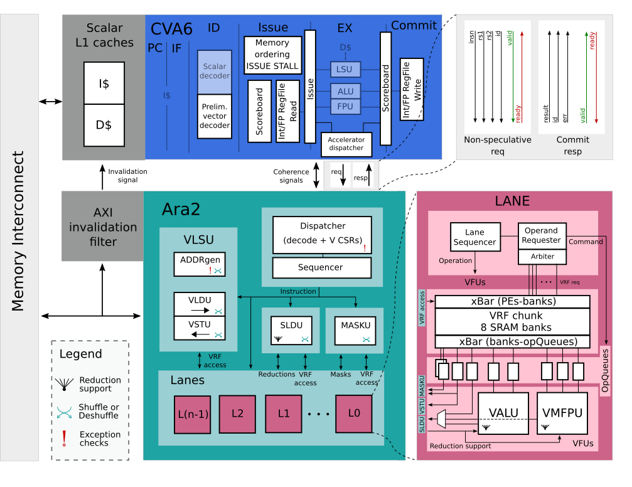
Differences between Ara1 and Ara2
Specs update (RVV0.5 -> RVV1.0)
New VRF layout
Mask Unit
New insn encoding
Reshuffling support
Fixed-point support
Int + FP reductions
Barber's pole
CVA6 – more agnostic on V
Coherence/ordering protocol

Slide 50
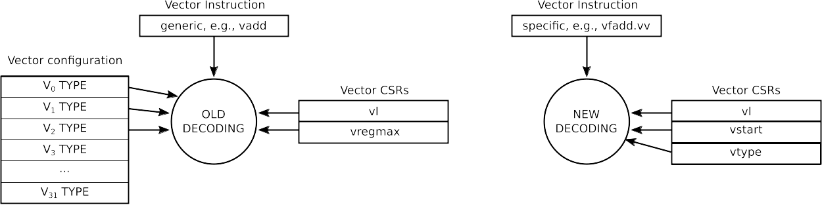
From Ara1 to Ara2 – ISA update
RVV 0.5
RVV 1.0
Polymorphic encoding
Compact ISA, harder decoding
Monomorphic encoding
Longer ISA, easier decoding

Slide 51
From Ara1 to Ara2 – ISA update
RVV 0.5
Need for VRF state to decode instruction
CVA6 was not vector agnostic
V-decoder in CVA6
RVV 1.0
Easier to decode instructions
CVA6 needs only minimal information to process V instructions
Push V-related hardware in Ara!

Slide 52
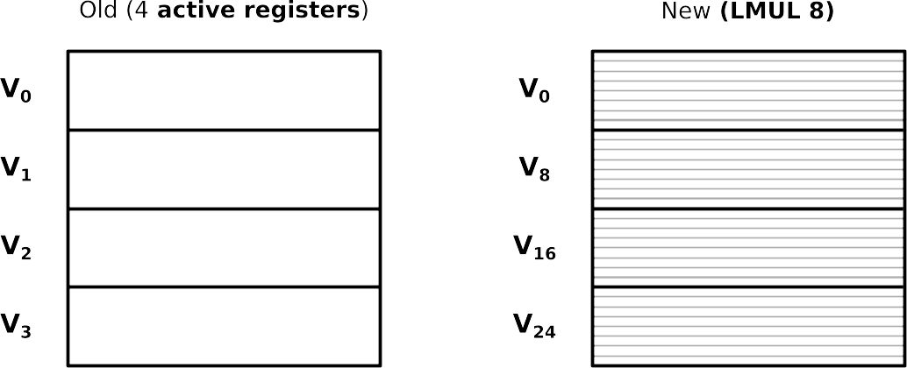
From Ara1 to Ara2 – ISA update​
RVV 0.5
RVV 1.0
Reg enable/length modified at runtime
Data-type per register
Constrained VRF setting
Data-type agnostic

Slide 53
From Ara1 to Ara2 – ISA update​
Simpler VRF configuration
VRF configuration is now static
32 vector registers, but they can be merged in groups of 2, 4, 8 registers (LMUL parameter == 2, 4, 8)
Interpret vector registers depending on SEW (single-element width) only

Slide 54
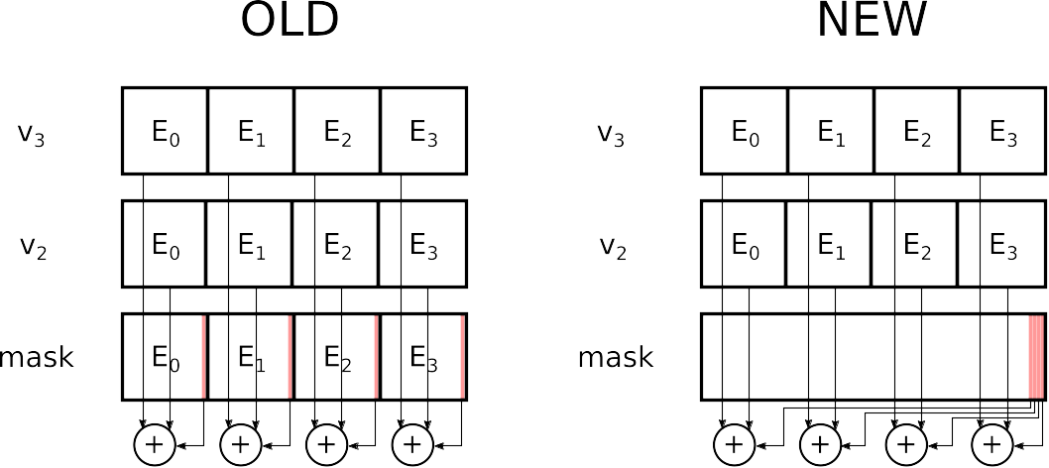
From Ara1 to Ara2 – ISA update
RVV 0.5
RVV 1.0
Mask bits aligned with elements
Mask bits compressed
Need for a dedicated unit that packs-unpacks mask bits - MASKU

Slide 55
From Ara1 to Ara2 – ISA update
Some units access the whole VRF
Each unit is connected to all the lanes (in and out)
All-to-all connected units:
VLSU
SLDU
MASKU (new!)
All-to-all connected units complicate rounting

Slide 56
Coherence/ordering protocol
Before
No hardware solution
Need for software fences
Memory Ordering
If vector store is ongoing block scalar loads/stores
If scalar store ongoing block vector loads/stores
If scalar/vector load is ongoing block vector/scalar stores
Cache coherence
Invalidate scalar cache lines upon vector store

Slide 57
Vector Reductions
Before
No vector reductions
After the update
Integer reduction
Floating-Point (FP) reduction
Ordered FP reduction

Slide 58
Vector Reductions
vs1
e0 | e1 | e2 | e3 | e4 | e5 | e6 | e7 | e8 | e9 | e10 | e11
vs2
s0 | - | - | - | - | - | - | - | - | - | - | -
vd
r0 | - | - | - | - | - | - | - | - | - | - | -
Notes:
Which instructions

Slide 59
Vector Reductions
Example: vredsum vd, vs1, vs2
vs1
e0 | e1 | e2 | e3 | e4 | e5 | e6 | e7 | e8 | e9 | e10 | e11
vs2
s0 | - | - | - | - | - | - | - | - | - | - | -
r0 = s0 + e0 + e1 + e2 + … + e11
vd
r0 | - | - | - | - | - | - | - | - | - | - | -
Notes:
Which instructions

Slide 60
Vector Reductions
Example: vredsum vd, vs1, vs2
vs1
e0 | e1 | e2 | e3 | e4 | e5 | e6 | e7 | e8 | e9 | e10 | e11
vs2
s0 | - | - | - | - | - | - | - | - | - | - | -
r0 = s0 + e0 + e1 + e2 + … + e11
vd
r0 | - | - | - | - | - | - | - | - | - | - | -
Notes:
Which instructions

Slide 61
Vector Reductions – Intra-lane phase start
vs1
e0 | e1 | e2 | e3 | e4 | e5 | e6 | e7 | e8 | e9 | e10 | e11
vs2
s0
LANE 0
LANE 1
LANE 2
LANE 3
vs1
e0 | e4 | e8
e1 | e5 | e9
e2 | e6 | e10
e3 | e7 | e11
vs2
s0
Notes:
Which instructions

Slide 62
Vector Reductions
LANE 0
LANE 1
LANE 2
LANE 3
vs1
e0 | e4 | e8
e1 | e5 | e9
e2 | e6 | e10
e3 | e7 | e11
vs2
s0
ALU
ALU
ALU
ALU
temp0 = s0 + e0 + e4 + e8
temp1 = e1 + e5 + e9
temp2 = e2 + e6 + e10
temp3 = e3 + e7 + e11
Notes:
Which instructions

Slide 63
Vector Reductions
LANE 0
e8
e4
e0
s0
ALU
Notes:
Which instructions

Slide 64
Vector Reductions
LANE 0
e8
e4
+
e0
s0
ALU
e0 + s0
Notes:
Which instructions

Slide 65
Vector Reductions
LANE 0
e8
e4
+
e0 + s0
ALU
e0 + s0 + e4
Notes:
Which instructions

Slide 66
Vector Reductions
LANE 0
e8
+
e0 + s0 + e4
ALU
e0 + s0 + e4 + e8
Notes:
Which instructions

Slide 67
Vector Reductions – Intra-Lane phase end
LANE 0
LANE 1
LANE 2
LANE 3
ALU
ALU
ALU
ALU
temp0
temp1
temp2
temp3
temp0 = s0 + e0 + e4 + e8
temp1 = e1 + e5 + e9
temp2 = e2 + e6 + e10
temp3 = e3 + e7 + e11
Notes:
Which instructions

Slide 68
Vector Reductions – Inter-Lane phase start
LANE 0
LANE 1
LANE 2
LANE 3
temp0
temp1
temp2
temp3
L0
L1
Notes:
Which instructions

Slide 69
Vector Reductions
LANE 0
LANE 1
LANE 2
LANE 3
temp0
temp1
temp2
temp3
Notes:
Which instructions

Slide 70
Vector Reductions
LANE 0
LANE 1
LANE 2
LANE 3
temp1
temp0
temp3
temp2
Notes:
Which instructions

Slide 71
Vector Reductions
LANE 0
LANE 1
LANE 2
LANE 3
temp01
temp23
temp01 = temp0 + temp1
temp23 = temp2 + temp3
Notes:
Which instructions

Slide 72
Vector Reductions
LANE 0
LANE 1
LANE 2
LANE 3
temp01
temp23
Notes:
Which instructions

Slide 73
Vector Reductions
LANE 0
LANE 1
LANE 2
LANE 3
temp0123
temp0123 = temp01 + temp23
Notes:
Which instructions

Slide 74
Vector Reductions
SLIDE
UNIT
LANE 0
LANE 1
LANE 2
LANE 3
ALU
ALU
ALU
ALU
temp0
temp1
temp2
temp3
Notes:
Which instructions

Slide 75
Vector Reductions
SLIDE
UNIT
LANE 0
LANE 1
LANE 2
LANE 3
ALU
ALU
ALU
ALU
temp0
temp2
temp1
temp3
Notes:
Which instructions

Slide 76
Vector Reductions
SLIDE
UNIT
LANE 0
temp0
LANE 1
LANE 2
LANE 3
temp2
ALU
ALU
ALU
ALU
temp1
temp3

Slide 77
Vector Reductions – Inter-Lane phase end
SLIDE
UNIT
LANE 0
LANE 1
LANE 2
LANE 3
ALU
ALU
ALU
ALU
temp0
temp2
temp1
temp3
Notes:
Which instructions

Slide 78
Vector Reductions – SIMD phase start
LANE 0
ALU
temp0123
64-bit
Notes:
Which instructions

Slide 79
Vector Reductions
Reduce the 64-bit packet of N elements
Example: four 16-bit elements
log2(N) operations for N sub-elements
Example: log2(4) = 2 operations
LANE 0
ALU
h0 | h1 | h2 | h3
64-bit
Notes:
Which instructions

Slide 80
Vector Reductions
Reduce the 64-bit packet of N elements
Example: four 16-bit elements
log2(N) operations for N sub-elements
Example: log2(4) = 2 operations
LANE 0
h0 | h1
+
h2 | h3
ALU
First operation
h01 | h23
Notes:
Which instructions

Slide 81
Vector Reductions – SIMD phase end
Reduce the 64-bit packet of N elements
Example: four 16-bit elements
log2(N) operations for N sub-elements
Example: log2(4) = 2 operations
LANE 0
h01
+
h23
ALU
Second operation
h0123
16-bit
Notes:
Which instructions

Slide 82
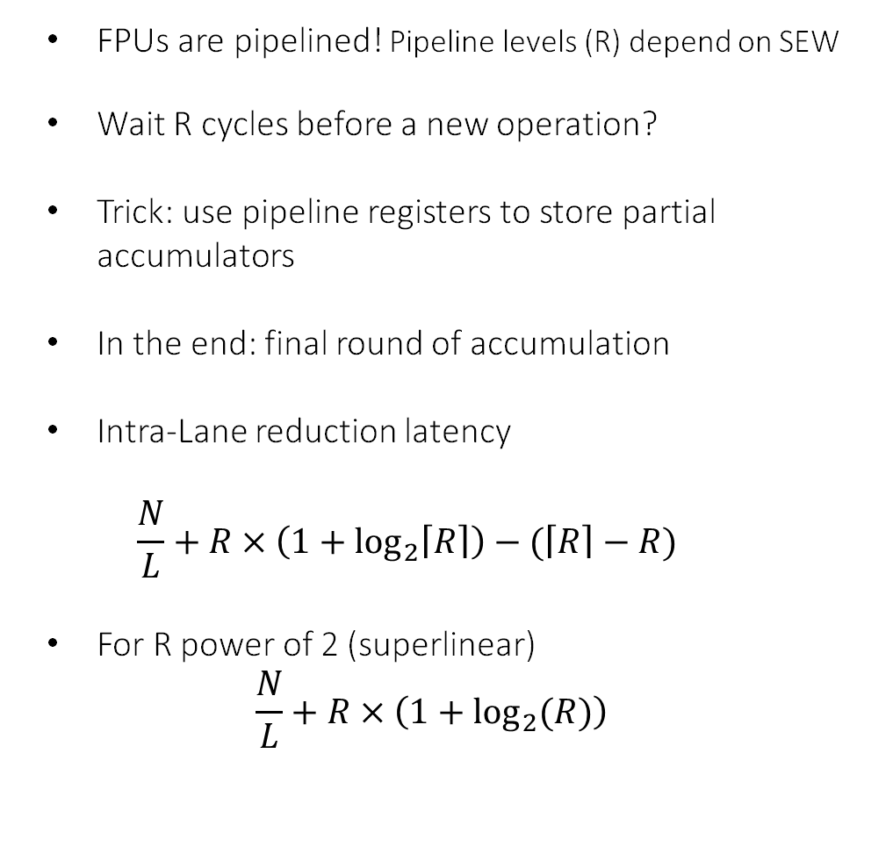
Floating-point reductions?
...
Op2
Op0
Op1
FPUs are pipelined! Pipeline levels (R) depend on SEW
Wait R cycles before a new operation?
Trick: use pipeline registers to store partial accumulators
In the end: final round of accumulation
Intra-Lane reduction latency $\frac{N}{L}+R×\left(1+\log_{2}\left\lceil R\right\rceil \right)−(\left\lceil R\right\rceil −R)$
For R power of 2 (superlinear) $\frac{N}{L}+R×\left(1+\log_{2}{(R)}\right)$
FPU
...
Op5
Op5
Op4
Op4
FPU
FPU
Op3
Op3
Op2
Op2
Op0 + Op1
Op0 + Op1
...
Op6
Op5
FPU
Op0 + Op1 + Op4
Op3
Op2

Slide 83
Verification and Software Eco-System
Verification
Update and extend riscv-tests repository
Every instruction has its own set of dedicated tests
Multiple self-verifying benchmarks implemented
Additional tests from external company
CI integrated on GitHub
Software eco-system
LLVM compiler + SPIKE updated more than once to follow specs update
Vector intrinsics support - Still in evolution from RISC-V community!
Verilator (open-source) to simulate the system
Initial support for auto-vectorization

Slide 84
Evaluation
Benchmarks
Linear Algebra, math: fmatmul, fconv2d, jacobi2d, dotp, exp, log, cos
Routing Algorithm: pathfinder
DSP: fft, dwt
ML: softmax, roi_align, dropout
AWB, spmv, ReLu, ... : not in the analysis
Throughput
vs. number of lanes (2, 4, 8, 16)
vs. vector length (4, 8, 16, 32, 64, 128 elements)
How scalar core and memory system influence performance?
RTL
Sim

Slide 85
Evaluation
Benchmarks
LA: fmatmul, fconv2d, jacobi2d, dotp, exp
RA: pathfinder
DSP: fft, dwt
ML: softmax, roi_align, dropout
Throughput
vs. number of lanes
vs. vector length
How scalar core and memory system influence performance?
Physical implementation
PPA metrics
Efficiency study
Scaling analysis
RTL
gf22
Synth
P&R
Sim
PPA metrics

Slide 86
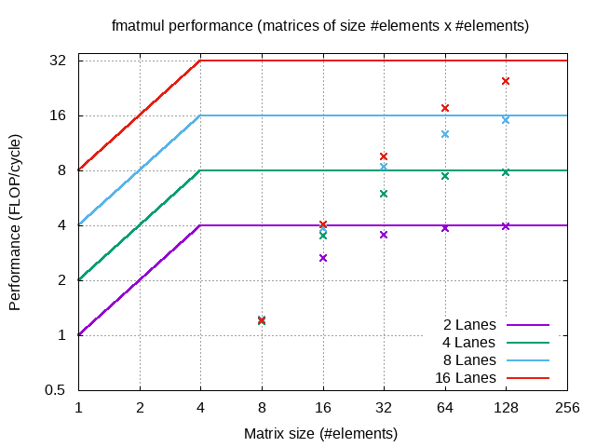
System performance – A focus on matmul
Up to 32 DP-FLOP/cycle
With 16 Lanes
FP-matmul
A[N][N] * B[N][N]

Slide 87
System performance – A focus on matmul
Up to 32 DP-FLOP/cycle
With 16 Lanes
FP-matmul
A[N][N] * B[N][N]
X-axis: Matrix Size N
Increasing arithmetic intensity!

Slide 88
System performance – A focus on matmul
Up to 32 DP-FLOP/cycle
With 16 Lanes
FP-matmul
A[N][N] * B[N][N]
X-axis: Matrix Size N
Always computation-bound
Increasing arithmetic intensity!

Slide 89
System performance – A focus on matmul
Up to 32 DP-FLOP/cycle
With 16 Lanes
FP-matmul
A[N][N] * B[N][N]
X-axis: Matrix Size N
Always computation-bound
Longer vector, better performance
Amortize setup time for V instruction
Amortize CVA6 non-idealities
>98.5% FPU Utilization

Slide 90
Issue-rate limitation
There is another intrinsic limitation to performance
Issue-rate limitation:
4-element vector
4-lane Ara (4 FPUs)
Max Throughput = 1 vfmacc/cycle
To reach full performance, Ara would need 1 vfmacc per cycle!
BUT, in the best case: 1 vfmacc every 3 cycles
// Loop kernel is a sequence of:
// bump pointer
add addr, 8
// load scalar from mtx A
ld x, @addr
// issue vfmacc
vfmacc v0, v1, x

Slide 91
System performance – A focus on matmul
Issue-rate limitation hits short/medium-vectors
Longer vectors hide CVA6's non-ideal issue-rate latency
i.e., with longer vectors, Ara does not starve

Slide 92
System performance – A focus on matmul
RVV 0.5:
2 instructions for vector-scalar operation
Issue-rate: 1/5 cycles
RVV 1.0:
1 instruction for vector-scalar operation
Issue-rate: 1/4 cycles

Slide 93
Software
Kernel | Domain | Format | Compute bound | Mask | Slide | Stride Mem | Idx Mem | Reduction | Max Perf [DP-FLOP/cycle]
matmul | Linear Algebra, ML | FP64, int64 | Y | N | N | N | N | N | 1 × 2.0 × L
conv2d | Signal Processing, ML | FP64, int64 | Y | N | Y | N | N | N | 1 × 2.0 × L
dotproduct | Linear Algebra | FP64, int64 | Y | N | N | N | N | Y | 1 × 0.5 × L*
jacobi2d | Stencil | FP64 | Y | N | Y | N | N | N | 1 × 1 × 1.0 × L
dropout | ML | FP32 | N | Y | N | N | N | N | 2 × 0.25 × L
fft | Signal Processing, | FP32 | Y | Y | Y | N | Y | N | 2 × 5/4 × L
dwt | Signal Processing, | FP32 | N | N | N | Y | N | N | 2 × 0.5 × L
pathfinder | Routing Algorithm | int32 | N | Y | N | N | N | N | 2 × 1.0 × L
exp | Scientific, ML | FP64 | Y | N | N | N | N | N | 1 × 28/21 × L
softmax | ML | FP32 | Y | N | N | N | N | Y | 2 × 32/25 × L
roi-align | ML | FP32 | N | N | N | N | N | N | 2 × 3/5 × L

Slide 94
Software
Kernel | Domain | Format | Compute bound | Mask | Slide | Stride Mem | Idx Mem | Reduction | Max Perf [DP-FLOP/cycle]
matmul | Linear Algebra, ML | FP64, int64 | Y | N | N | N | N | N | 1 × 2.0 × L
conv2d | Signal Processing, ML | FP64, int64 | Y | N | Y | N | N | N | 1 × 2.0 × L
dotproduct | Linear Algebra | FP64, int64 | Y | N | N | N | N | Y | 1 × 0.5 × L*
jacobi2d | Stencil | FP64 | Y | N | Y | N | N | N | 1 × 1 × 1.0 × L
dropout | ML | FP32 | N | Y | N | N | N | N | 2 × 0.25 × L
fft | Signal Processing | FP32 | Y | Y | Y | N | Y | N | 2 × 5/4 × L
dwt | Signal Processing | FP32 | N | N | N | Y | N | N | 2 × 0.5 × L
pathfinder | Routing Algorithm | int32 | N | Y | N | N | N | N | 2 × 1.0 × L
exp | Scientific, ML | FP64 | Y | N | N | N | N | N | 1 × 28/21 × L
softmax | ML | FP32 | Y | N | N | N | N | Y | 2 × 32/25 × L
roi-align | ML | FP32 | N | N | N | N | N | N | 2 × 3/5 × L

Slide 95
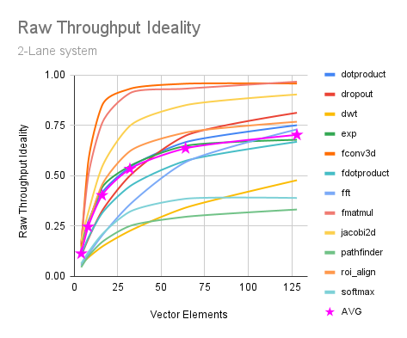
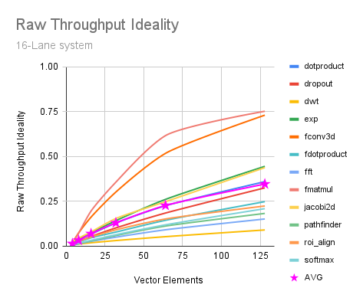
Throughput ideality
Benchmark performance analysis
Throughput ideality = Throughput/Max_Throughput
It measures degree of ideality of the Ara system for that kernel from 0% to 100%
Throughput ideality strongly depends on number of lanes and vector length
>50% of performance on average from 16 Elements/Lane on
>75% of performance from 8 Elements/Lane for highly intensive kernels (fmatmul, fconv2d, ~jacobi2d)
Notes:
Update kernel plots and update

Slide 96
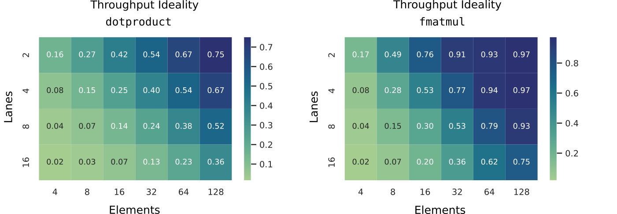
Throughput ideality - Byte/Lane ratio
Throughput ideality
i.e., actual/ideal performance
Measure of how ideally Ara behaves
The longer the vector, the better the throughput ideality (until peak)
How long is a "sufficiently long" vector?
Performance ideality correlated with Byte/Lane ratio (~Element/Lane)
Same computational efficiency with 2*L? Our vector should be as twice as long
i.e., to double performance, we need a longer vector too

Slide 97
Performance analysis
Ara2 suffers from short/medium vector performance loss
Who to blame? CVA6? Memory System? Vector accelerator?
Analyze three systems
CVA6 + Scalar I/D$ + Ara
Show limitations due to the whole system
CVA6 + Ideal I/D$ + Ara
Show limitations due to CVA6 and Ara
Ideal CVA6 + Ideal I/D$ + Ara
Show limitations due to Ara
CVA6
Ara
I$
D$
Mem
CVA6
Ara
Ideal
Mem
Ideal
Ara
Ideal
Mem

Slide 98
Performance analysis
Ara2 suffers from short/medium vector performance loss
Who to blame? CVA6? Memory System? Vector accelerator?
Analyze three systems
CVA6 + Scalar I/D$ + Ara
Show limitations due to the whole system
CVA6 + Ideal I/D$ + Ara
Show limitations due to CVA6 and Ara
Ideal CVA6 + Ideal I/D$ + Ara
Show limitations due to Ara
CVA6
Ara
I$
D$
Default/vanilla
system
Mem
CVA6
Ara
Inf size
uncoherent
Ideal cache
system
Mem
V insn FIFO
Ara
Ideal dispatcher system
Mem

Slide 99
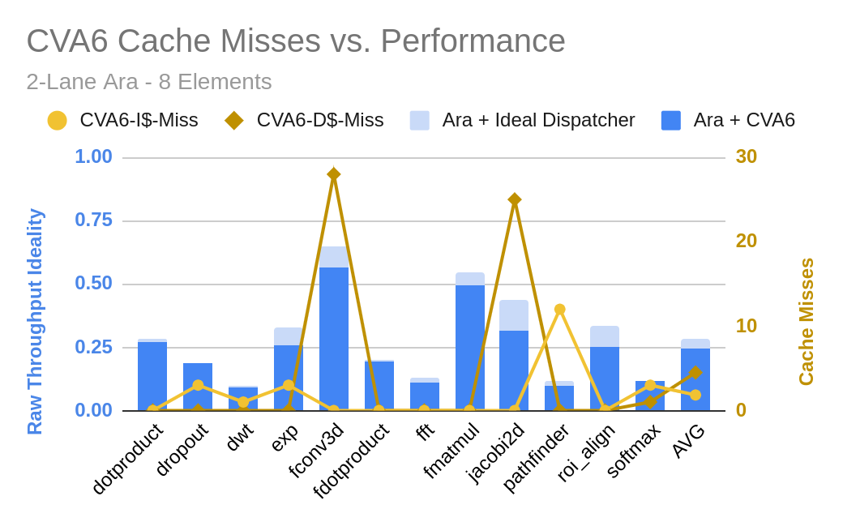
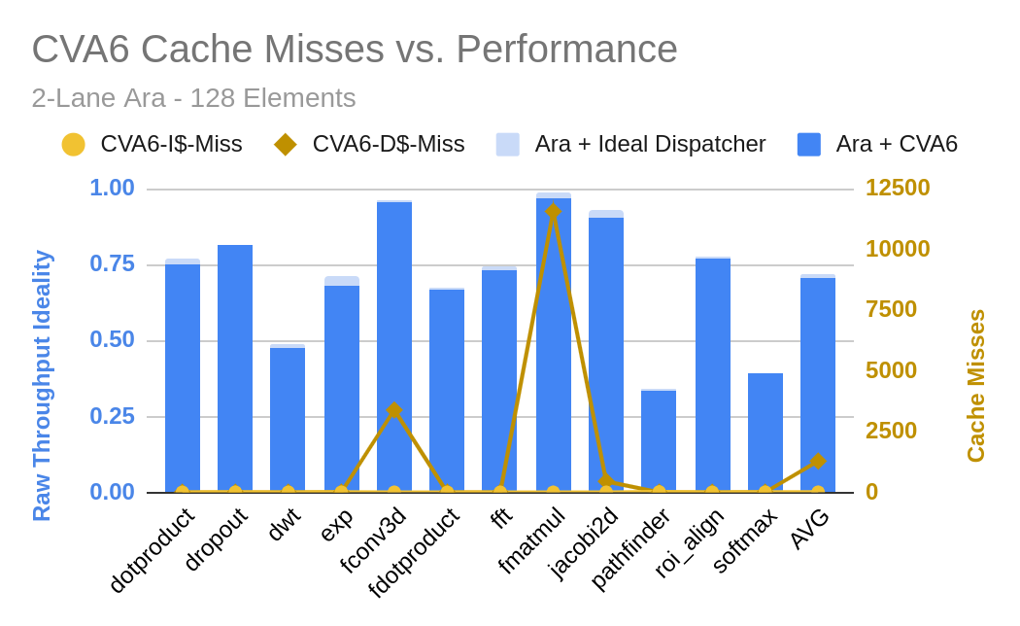
CVA6 influence on performance
Ideal dispatcher does not improve performance much!
(2-lane Ara, 8-element vector)
Almost no performance gain for long vectors
(2-lane Ara, 128-element vector)

Slide 100
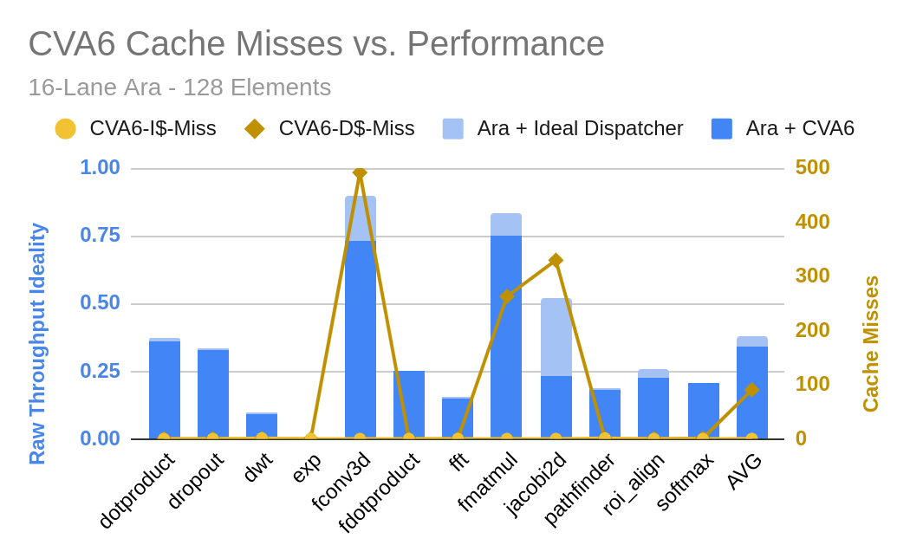
CVA6 influence on performance
16 lanes, 128 elements case
Correlation with D$ misses even more evident

Slide 101
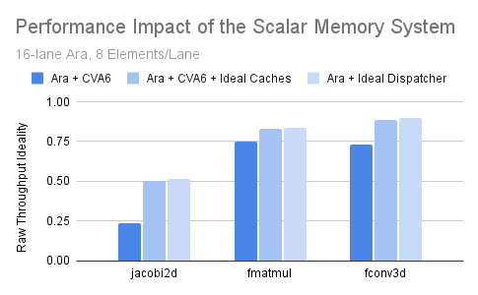
CVA6 influence on performance
The performance gain should be attributed to the ideal caches, and not to the ideal CVA6!
All three kernels rely on scalar forwarding from scalar to vector core!
D$ misses heavily affect performance!
fmatmul, fconv2d
Source and destination separated in memory
Problem: cache line/bus size
jacobi2d:
Iterative algorithm
Elements written by vector store get read back from the scalar core (from the D$!)
Problem: scalar cache

Slide 102
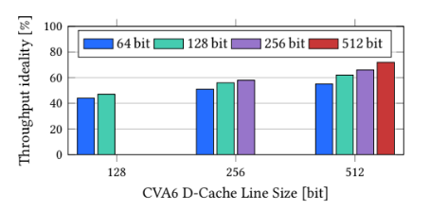
Scalar D$ influence on performance
16 Lanes, fmatmul, n = 16
Throughput ideality vs.
AXI data-width
D$ line-width
Ara2
CVA6
D$ line-width
AXI data-width
AXI xBAR
AXI data-width
Miss penalty
From 42% to 72%!
Hit rate
Miss penalty

Slide 103
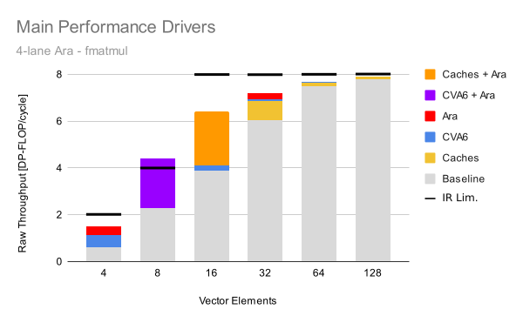
Main performance drivers
Absolute fmatmul performance of a 4-lane Ara
Different performance drivers for different sizes
Orange and violet are merged gains
Huge CVA6 impact with short vectors only
Caches play a role for medium vectors
Long vectors are already at their peak
Issue-Rate limitation does not hold for ideal CVA6, but holds for the real system!

Slide 104
Ara wants more Computational Power
2 FPUs
4 FPUs
8 FPUs
16 FPUs
FPUs per Ara

Slide 105
Ara wants more Computational Power
2 FPUs
4 FPUs
8 FPUs
16 FPUs
FPUs per Ara
1 Ara
2 Ara
Both systems have 16 FPUs
4 Ara
exploration
Number of Aras

Slide 106
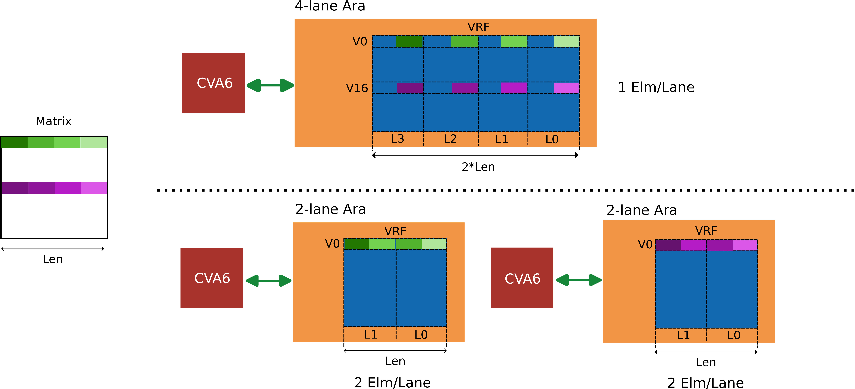
Single core vs. Multi core
Increase Byte/Lane ratio with Multi-Core?
Exploit second dimension!

Slide 107
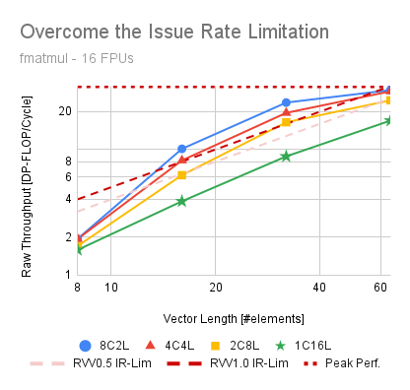
Single core vs. Multi core system
16 FPU system in different flavors
1C16L: one 16-lane Ara
8C2L: eight 2-lane Ara
e.g., 32x32x32 matmul performance
32 elements processed by a single 16-lane Ara
under-utilize the system's resources (2 Elm/Lane)
Eight 2-lane Aras exploit the second dimension of the matrix to speed up the computation (16 Elm/Lane)
The issue-rate limitation does not exist for 8C2L
32

Slide 108
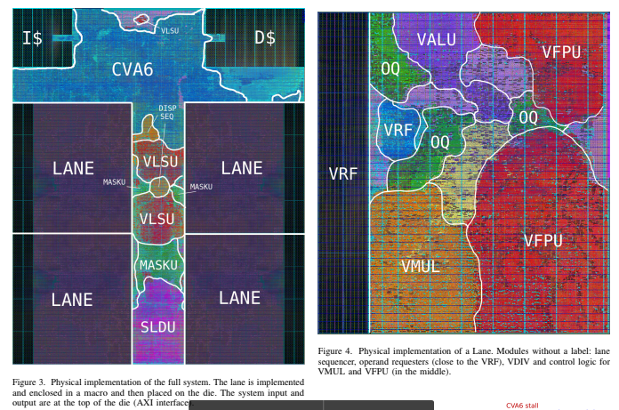
Physical Implementation
GF22 FDX FD-SOI
SS frequency: 950 MHz
TT frequency: 1.35 GHz
Efficiency: 37.8 DP-GFLOPS/W
1.35GHz, fp-matmul
1 mm2
0.95 mm2

Slide 109
Physical Implementation

Slide 110
Physical Implementation

Slide 111
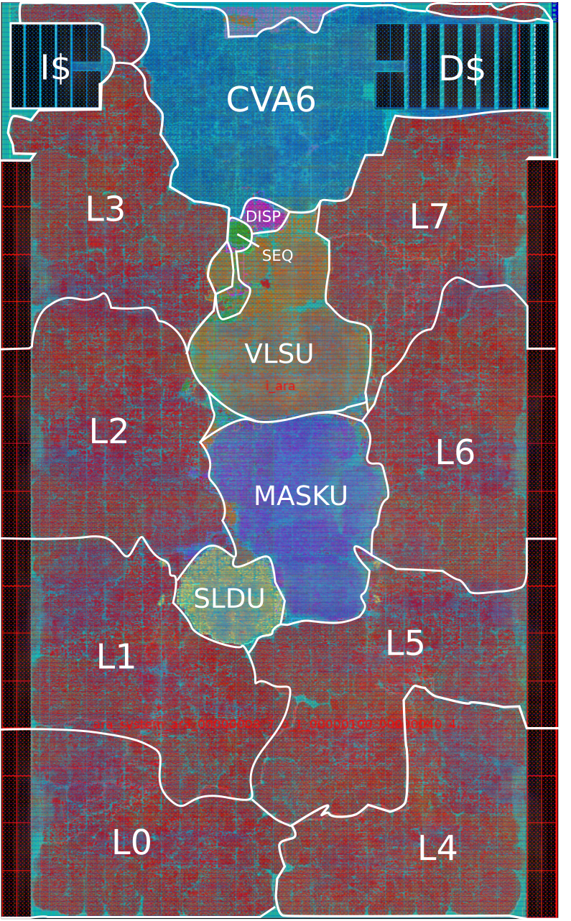
Physical Implementation – Scaling up
Scale up with the number of lanes
Flat flow for #L > 8

Slide 112
PPA Metrics
AraV2 (Arav1) | 2 lanes | 4 lanes | 8 lanes | 16 lanes*
SS Frequency [MHz] | 950 (920) | 960 (930) | 940 (870) | 860 (780)
TT Frequency [GHz] | 1.35 (1.25) | 1.35 (1.25) | 1.35 (1.17) | 1.26 (1.04)
Die Area (mm2) | 0.588 | 0.953 | 1.876 | 4.47
Cell+Macro Area (mm2) | 0.455 (0.443) | 0.734 (0.683) | 1.346 (1.174) | 2.559 (2.136)
Macro Area (mm2) | 0.111 | 0.153 | 0.235 | 0.4
Peak Efficiency | 34.1 (35.6) | 37.7 (37.8) | 35.7 (39.9) | 30.3 (40.8)
*Simplified Mask Unit
Improved SS, TT frequency
Smaller die, slightly higher Cell+Macro area (with added functionality)
Same efficiency up to 4 lanes, then the trend is different
RVV 0.5 gains in efficiency until 16 lanes
Efficiency peak at 4 lanes for RVV 1.0 design

Slide 113
Area breakdown
Area [kGE] | 2L | 4L | 8L | 16L | 16L*
CVA6 | 894 | 896 (1.0×) | 906 (1.0×) | 904 (1.0×) | 904 (1.0×)
Lane | 612 | 617 (1.0×) | 626 (1.0×) | 628 (1.0×) | 573 (0.9×)
Dispatcher | 16 | 17 (1.1×) | 19 (1.1×) | 23 (1.2×) | 20 (1.1×)
Sequencer | 14 | 15 (1.1×) | 17 (1.2×) | 29 (1.6×) | 29 (1.6×)
MASKU | 38 | 97 (2.5×) | 300 (3.1×) | 1105 (3.7×) | 442 (1.5×)
ADDRGEN | 35 | 36 (1.0×) | 44 (1.2×) | 59 (1.3×) | 60 (1.4×)
VLDU | 15 | 45 (3.0×) | 212 (4.7×) | 1286 (6.1×) | 1135 (5.4×)
VSTU | 8 | 21 (2.8×) | 64 (3.1×) | 332 (5.2×) | 342 (5.3×)
New SLDU | 24 | 48 (2.0×) | 94 (2.0×) | 196 (2.1×) | 190 (2.1×)
Old SLDU | 39 | 131 (3.4×) | 577 (4.4×) | 2900 (5.0×) | 2860 (5.0×)

Slide 114
uArch optimization: Slide Unit
SLDU made scaling up to 16 lanes impossible
Exponential growth after P&R
All-to-all byte connections scale ~L^2
Do we need to support whichever slide amount?
Area [kGE] | 2L | 4L | 8L | 16L
New SLDU | 24 | 48 (2.0×) | 94 (2.0×) | 196 (2.1×)
Old SLDU | 39 | 131 (3.4×) | 577 (4.4×) | 2900 (5.0×)

Slide 115
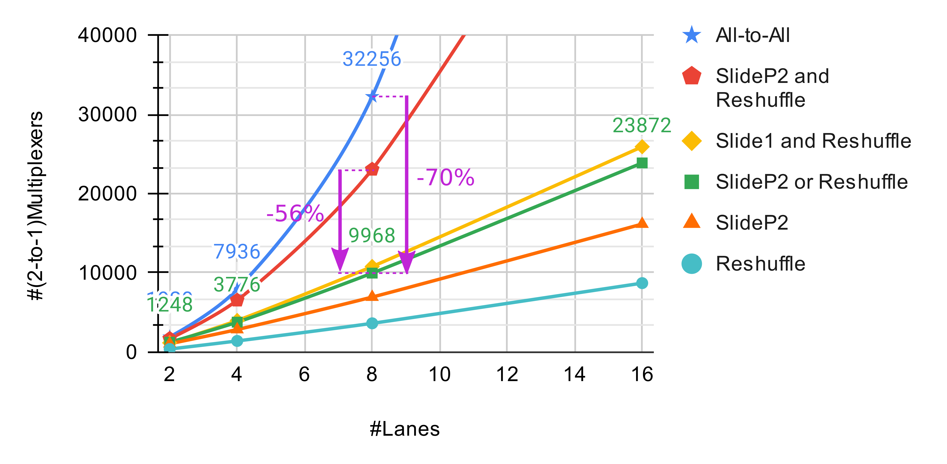
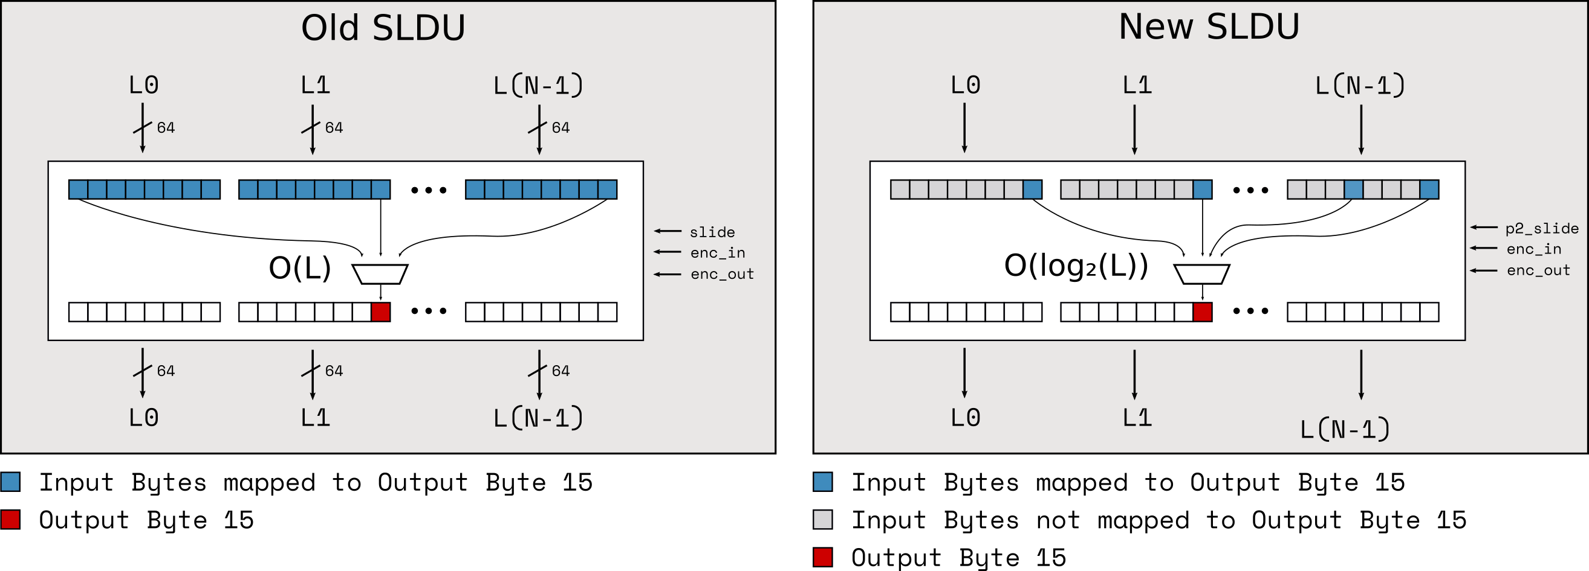
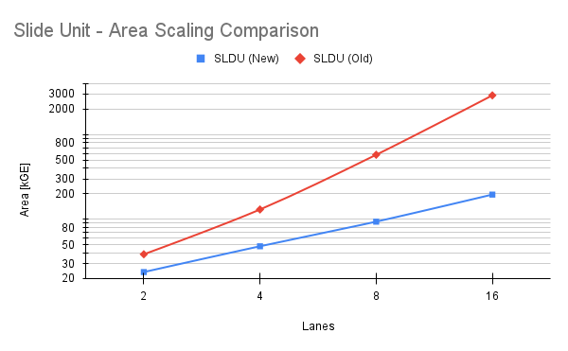
uArch optimization: Slide Unit
SLDU made scaling up to 16 lanes impossible
Exponential growth
All-to-all byte connections scale ~L^2
Do we need to support whichever slide amount?
Solution
Support only power-of-2 slide amounts
Either reshuffle OR slide
Area [kGE] | 2L | 4L | 8L | 16L
New SLDU | 24 | 48 (2.0×) | 94 (2.0×) | 196 (2.1×)
Old SLDU | 39 | 131 (3.4×) | 577 (4.4×) | 2900 (5.0×)

Slide 116
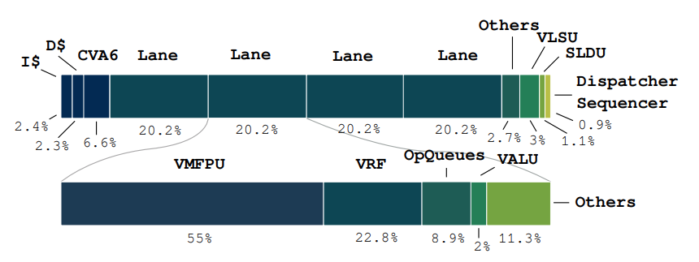
Power breakdown
4 Lanes
FP-matmul computational loop

Slide 117
Power breakdown
11% power to CVA6
4 Lanes
FP-matmul computational loop

Slide 118
Power breakdown
>80% power to the Lanes
4 Lanes
FP-matmul computational loop

Slide 119
Power breakdown
4 Lanes
FP-matmul computational loop

Slide 120
Power breakdown
~30% Buffering
4 Lanes
FP-matmul computational loop

Slide 121
Power breakdown
55% Actual Computation
4 Lanes
FP-matmul computational loop

Slide 122
Energy Efficiency
Boost energy efficiency
Clock-gate unused CVA6 memory banks, VRF banks
Operand-gate the SIMD multipliers
Clock-gate the SIMD multipliers when not used
Ara 4 Lanes, fmatmul A[128][128] x [128][1KiB] = C[128][1KiB]
Fmt Eff
fp64 37.74 DP-FLOPS/W
fp32 90.04 SP-FLOPS/W
fp16 195.86 HP-FLOPS/W
int64 38.32 DP-GOPS/W
int32 85.26 SP-GOPS/W
int16 180.56 HP-GOPS/W
int8 376.04 BP-GOPS/W

Slide 123
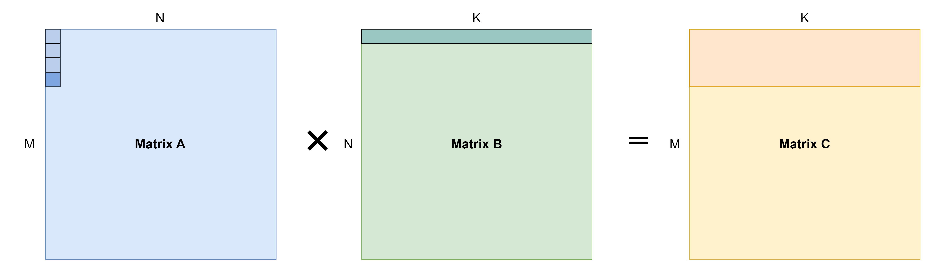
ISA extension – Transformers and small Matmul
Improve small-size matmul?
Default algorithm
Example: 32x32x32 fp32-matmul (4*32) output tile 4-Lane Ara
4 scalar loads (D$ misses)
4 vmacc instructions (4 setup time, issue-rate limitation)
4 Elements/Lane -> 16 B/Lane
L3
L2
L1
L0
FPU
FPU
FPU
FPU

Slide 124
ISA extension – Transformers and small Matmul
Improve small-size matmul?
Matrix algorithm
Example: 32x32x32 fp32-matmul (4*32) output tile 8-Lane Ara
0 scalar loads (no D$ misses)
1 mmacc instruction (1 setup time)
32 Elements/Lane -> 64 B/Lane
Broadcast
L3
L2
L1
L0
FPU
FPU
FPU
FPU

Slide 125
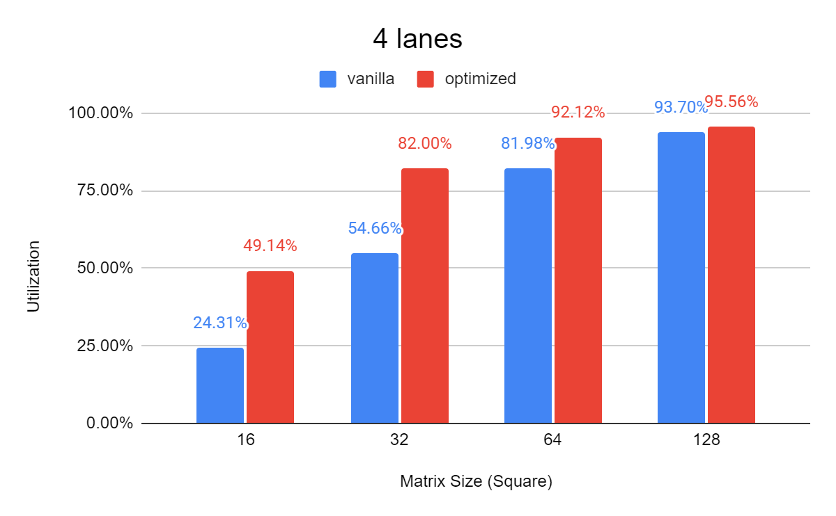
ISA extension – Transformers and small Matmul
Improve small-size matmul?
Default algorithm vs. Optimized Matrix algorithm
Matmul Utilization (4 Lanes)
Default
Optimized
Peak of 2x performance for small problems!!

Slide 126
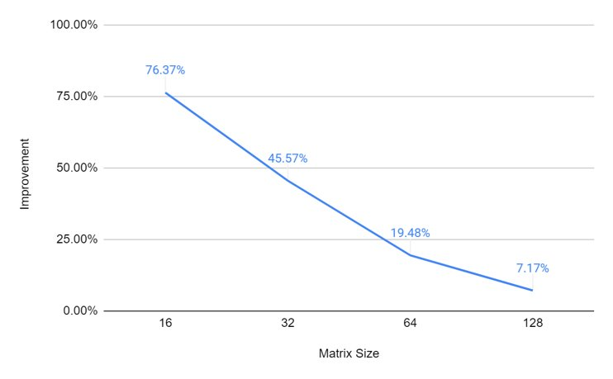
ISA extension – Transformers and small Matmul
Trial on 2, 4, 8 lanes – No frequency loss, negligible area impact
What about Energy Efficiency? 4-lane Ara example
Peak of +75% EE improvement on small problems!

Slide 127
SoA Comparison
Vitruvius+
8-lane processor
~ Max frequency for 8 Lanes
~ IPC on jacobi2d, matmul, pathfinder
Unfair power comparison (no scalar core? No caches? How data are generated?)
Vicuna
int-only RVV1.0
~ utilization on matmul
FPGA only PPA metrics
Hwacha
~ utilization on matmul
Chip-level Power, hard to compare

Slide 128

Yun: Ara’s in tsmc65
Yun - tsmc65
Ara – 4 Lanes
SoC Architecture
Ara System
64 KiB SRAM Memory
JTAG + Debug Module
Double-precision FPU
Die area: 6 mm2
Frequency: ~250 MHz
Already tested: it works!

Slide 129
What's further?
OS support
Virtual memory
Re-use CVA6's MMU
Separate TLB for V accesses?
Context switch
Restrict V core to one process only
Faster context switch
Exceptions
Extensive debug
Ara
vld (virtual @)
CVA6
@ translation
VLSU
MMU
vld req (physical @)
Memory

Slide 130
What's further?
Matrix Extension
Load matrices instead of vectors
Decouple Scalar-Vector processors
Bypass D$!
Increase #operations/#instruction ratio
Pay less start-up time cycles
Reduce VRF accesses

Slide 131
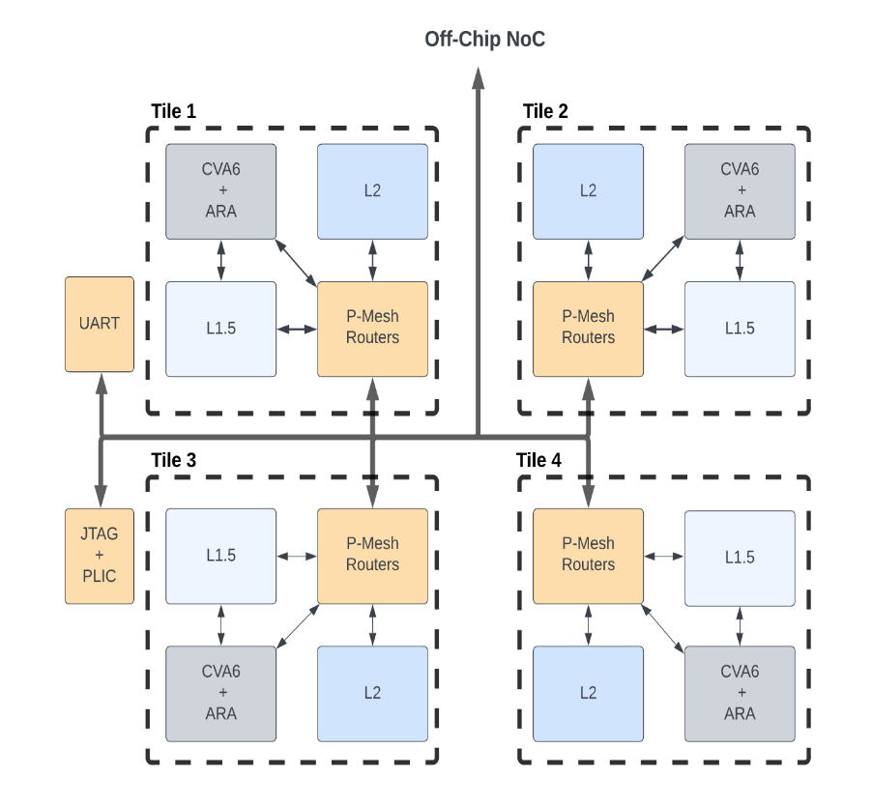
What's further?
Ara OpenPITON – PolAra
Ara in real multi-core environment
Optimizing matmul on L2-sparse memory hierarchy
https://github.com/openhwgroup/core-v-polara-apu/tree/openpiton_polara

Slide 132
Project goals
Expand benchmark pool with heterogeneous applications for high-dimensional workloads
Extended benchmark pool with heterogeneous set of kernels and program to stress different units of Ara2
Performance analysis for each kernel and degree of ideality w.r.t. the maximum achievable
Update Ara from RISC-V V v0.5 to the most recent RISC-V Vector ISA (v0.9)
Ara updated to RISC-V V v1.0 frozen
Added RVV features missing from AraV1 (e.g., int- and fp-reductions)
Develop uArchitecture to improve IPC, Performance, Energy Efficiency
uArchitectural optimization (e.g., SLDU optimization) to scale up to 8 and 16 lanes
Exploration of new ISA extension to speed up transformer models
Transprecision FPU down to 16 bit, ready to host 16alt and 8-bit formats
Higher performance (frequency), same Energy Efficiency for smaller Ara instances
Address coherence problem between Ara and Ariane
Added coherence and memory ordering engine
HW/SW interface mixing intrinsics, hand-optimized macros, vector compilation
Compiler support with RVV intrinsics
Benchmark pool and optimized programs with intrinsics, hand-optimized macros, and possibly auto-vectorization

Slide 133
Publications
Published:
ASAP 2022 Conference
Title: A “New Ara” for Vector Computing: An Open Source Highly Efficient RISC-V V 1.0 Vector Processor Design
Authors: Matteo Perotti, Matheus Cavalcante, Nils Wistoff, Renzo Andri, Luca Benini
Link: https://ieeexplore.ieee.org/abstract/document/9912071
Work in progress:
IEEE Journal TCOMP

Slide 135
EFCL Project Timeline, WPs, Milestones
Year 1
WP1: Workload analysis and benchmarking Select target sensors and key algorithms - develop a benchmark suite with performance targets for key application kernels used in multi-dimensional sensor processing and fusion for consumer devices.
WP2: uArch design and exploration of instruction extensions Moving from ARAv1 develop the new micro-architecture supporting the standard ISA and evaluate the impact in HW cost and performance benefits of instruction extensions targeted to the workloads in WP1.
Milestones: workload and benchmark analysis, version 0.1 of Ara2 with performance profiling
Year 2
WP3: uArch opt and implementation Moving from version 0.1 the goal is to develop an optimized microarchitecture, design with a target frequency in the GHz range and support for the ISA extension explored in WP2. The design will emphasize scalability to large lane count and high energy efficiency. PPA of the resulting design will be assessed
WP4: design space exploration, sw environment, open-source release The main goal of this WP is to verify the design of VP4, provide software support (intrinsics, optimized libraries, preliminary support for vectorization). An open-source release of HW and SW will be prepared with documentation.
Milestones: version 1.0 of Arav2 with instruction extensions and PPA analysis, open source release of HW and SW

Slide 136
Often need for more buffering space
Memory
Program (matmul)
Matrix A
Matrix B
Matrix C
Scalar
Register File
6x6
Matrix Tile
3x3
Matrix Tile
The tile does not fit
Pointers
Housekeeping

Slide 137
Vector Register File (VRF) – L0 buffer
Memory
Vector Register File
Large Matrix Tile
Program (matmul)
VLEN
Matrix A
Matrix B
Matrix C
Scalar
Register File
Scalar
Data
3x3
Matrix Tile
Pointers
Housekeeping

Slide 138
VRF – L0 buffer
Memory
VEC
Vector Register File
Large Matrix Tile
Program (matmul)
Matrix A
Matrix B
Matrix C
SCALAR CORE
RF
Scalar
Data
3x3
Matrix Tile
Pointers
Housekeeping

Slide 139
SIMD computation – tackle the VNB
Memory
VEC
Vector Register File
Large Matrix Tile
Program (matmul)
Matrix A
Matrix B
Matrix C
SCALAR CORE
1 Instruction
RF
Scalar
Data
3x3
Matrix Tile
MUCH computation
Pointers
Housekeeping

Slide 140
SIMD computation – tackle the VNB
Memory
VEC
Vector Register File
64
Large Matrix Tile
Program (matmul)
64
64
Matrix A
Matrix B
Matrix C
SCALAR CORE
RF
Scalar
Data
3x3
Matrix Tile
Pointers
Housekeeping

Slide 141
Example of vector code
Vector Addition
C[i]=A[i]+B[i]
Why Vector?
Reduce Von-Neumann Bottleneck
Higher buffering capabilities
Vector length agnostic, reduced ISA
// Scalar code
for (int i = N; i > 0; --i) {
ld a
ld b
add(c, a, b)
st c
// bump pointers
}
Notes:
45 s

Slide 142
Example of vector code
Vector Addition
C[i]=A[i]+B[i]
Why Vector?
Reduce Von-Neumann Bottleneck
Higher buffering capabilities
Vector length agnostic, reduced ISA
// Scalar code
for (int i = N; i > 0; --i) {
ld a
ld b
add(c, a, b)
st c
// bump pointers
}
// Vector code
for (int vl = get_vl(N); N > 0; N -= vl) {
vld va
vld vb
vadd(vc, va, vb)
vst vc
// bump pointers and get vl
}

Slide 143
Example of vector code
Vector Addition
C[i]=A[i]+B[i]
Why Vector?
Reduce Von-Neumann Bottleneck
Higher buffering capabilities
Vector length agnostic, reduced ISA
// Scalar code
for (int i = N; i > 0; --i) {
ld a
ld b
add(c, a, b)
st c
// bump pointers
}
// Vector code
for (int vl = get_vl(N); N > 0; N -= vl) {
vld va
vld vb
vadd(vc, va, vb)
vst vc
// bump pointers and get vl
}
2N loads
N add
N stores
4N FETCHED, DECODED
Scalar – 1 instruction == 1 operation
Vector – 1 instruction == [vl] operations
2N/vl loads
N/vl add
N/vl stores
4N/vl FETCHED, DECODED

Slide 144
Example of vector code
Vector Addition
C[i]=A[i]+B[i]
Why Vector?
Reduce Von-Neumann Bottleneck
Higher buffering capabilities
Vector length agnostic, reduced ISA
// Scalar code
for (int i = N; i > 0; --i) {
ld a
ld b
add(c, a, b)
st c
// bump pointers
}
// Vector code
for (int vl = get_vl(N); N > 0; N -= vl) {
vld va
vld vb
vadd(vc, va, vb)
vst vc
// bump pointers and get vl
}
2N loads
N add
N stores
4N FETCHED, DECODED
Scalar – 1 instruction == 1 operation
Vector – 1 instruction == [vl] operations
2N/vl loads
N/vl add
N/vl stores
Lower pressure on memory!
Less power required!
4N/vl FETCHED, DECODED

Slide 145
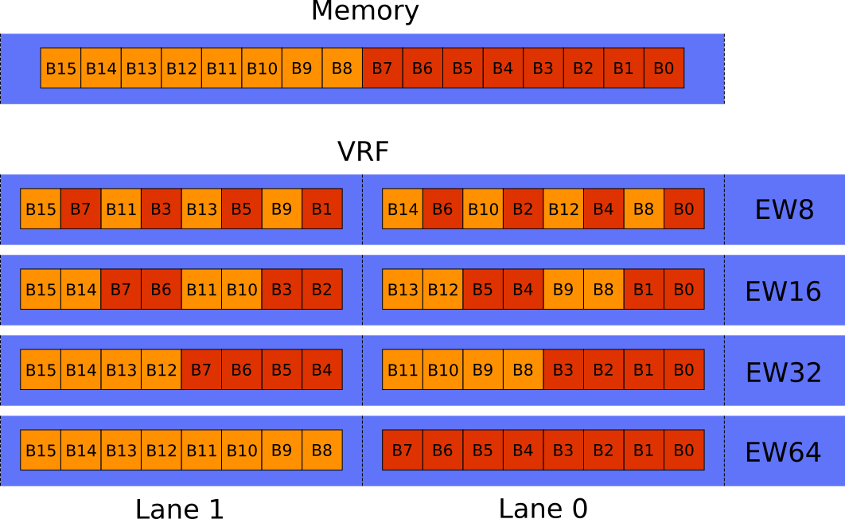
RVV < 1.0 - SLEN parameter
RVV < 1.0
VLEN: size of a single vector register (bits)
SLEN: size of a chunk of a vector register in a lane (bits)
SEW: single element width (bits)
SLEN = VLEN/#Lanes
Lane-friendly
Successive elements in successive lanes
SEW
L1
L0
Example: VLEN = 128 bit SLEN = 64 bit
v0
32 vregs
v31
8B
8B

Slide 146
RVV 1.0 - No SLEN parameter
RVV 1.0
VLEN: size of a single vector register (bits)
SEW: single element width (bits)
VRF Byte layout == Memory Byte layout
Non Lane-friendly
Widening instructions become a problem
During a widening, elements would need to be moved across lanes
To ease widening instructions, we mimick an SLEN parameter.
But we need to be able to reconstruct the vector as if it was buffered without SLEN!

Slide 147
Byte mapping (memory – VRF)
EW16
v0
B1
B0
L0
MAPPING
Memory(B1) - v0(B1, L0)
Memory
B1
B0
…
vld v0, (Memory)
…
L1
L2
L3
EW8
v0
B1
B0
L0
MAPPING
Memory(B1) - v0(B0, L1)
Memory
B1
B0
…
vld v0, (Memory)
…
L1
L2
L3

Slide 148
Byte mapping (memory – VRF)
EW16
B1
B0
L0
MAPPING
v0(B0, L1) - Memory(B2)
Memory
L1
B3
B2
B1
B0
…
vst v0, (Memory)
…
L2
L3
EW8
v0
B1
B0
L0
MAPPING
v0(B0, L1) - Memory(B1)
Memory
L1
…
vst v0, (Memory)
…
B3
B2
B1
B0
L2
L3

Slide 149
Ara VRF
Memory (outside Ara)
Vector with 8 elements
2 Byte/element
B15
B14
B13
B12
B11
B10
B9
B8
B7
B6
B5
B4
B3
B2
B1
B0
H1
H0
G1
G0
F1
F0
E1
E0
D1
D0
C1
C0
B1
B0
A1
A0
…
vld v0, (Memory)
…
v0 (VRF, inside VU1.0)
B15
B14
B13
B12
B11
B10
B9
B8
B7
B6
B5
B4
B3
B2
B1
B0
L0
E1
E0
A1
A0
MAPPING
v0 (EW16)
L1
F1
F0
B1
B0
L2
G1
G0
C1
C0
L3
H1
H0
D1
D0

Slide 150
Ara VRF
Memory (outside Ara)
Vector with 1 elements
1 Byte/element
B15
B14
B13
B12
B11
B10
B9
B8
B7
B6
B5
B4
B3
B2
B1
B0
A0
…
vld v0, (Memory)
…
v0 (VRF, inside VU1.0)
B15
B14
B13
B12
B11
B10
B9
B8
B7
B6
B5
B4
B3
B2
B1
B0
L0
E1
E0
A1
A0
MAPPING
v0 (EW8)
L1
F1
F0
B1
B0
L2
G1
G0
C1
C0
L3
H1
H0
D1
D0

Slide 151
Ara VRF
Memory (outside Ara)
Vector with 1 elements
1 Byte/element
B15
B14
B13
B12
B11
B10
B9
B8
B7
B6
B5
B4
B3
B2
B1
B0
A0
…
vld v0, (Memory)
…
v0 (VRF, inside VU1.0)
B15
B14
B13
B12
B11
B10
B9
B8
B7
B6
B5
B4
B3
B2
B1
B0
L0
E1
E0
A1
A0
MAPPING
v0 (EW8)
L1
F1
F0
B1
B0
L2
G1
G0
C1
C0
Tail elements get CORRUPTED
They were shuffled as EW16, but we lost that information
L3
H1
H0
D1
D0

Slide 152
Reshuffle (undisturbed policy)
New data-width in the destination and tail elements exposed?
Reshuffle destination with new encoding!
Byte mapping is preserved!
V0 mapping: EW16
L0
E1
E0
A1
A0
L1
F1
F0
B1
B0
vld, ew16
vld, ew8
L2
G1
G0
C1
C0
L3
H1
H0
D1
D0
t

Slide 153
Reshuffle (undisturbed policy)
New data-width in the destination and tail elements exposed?
Reshuffle destination with new encoding!
Byte mapping is preserved!
Reshuffle injected when needed
V0 mapping: EW16
V0 mapping: EW8
L0
E1
E0
A1
A0
L0
G0
E0
C0
A0
L1
F1
F0
B1
B0
L1
G1
E1
C1
A1
vld, ew16
vld, ew8
reshuffle
L2
G1
G0
C1
C0
L2
H0
F0
D1
B0
L3
H1
H0
D1
D0
L3
H1
F1
D0
B1
t

Slide 154
Reshuffle (undisturbed policy)
New data-width in the destination and tail elements exposed?
Reshuffle destination with new encoding!
Byte mapping is preserved!
Reshuffle injected when needed
V0 mapping: EW16
V0 mapping: EW8
V0 mapping: EW8
L0
E1
E0
A1
A0
L0
G0
E0
C0
A0
L0
G0
E0
C0
A0
L1
F1
F0
B1
B0
L1
G1
E1
C1
A1
L1
G1
E1
C1
A1
vld, ew16
vld, ew8
reshuffle
vld, ew8
L2
G1
G0
C1
C0
L2
H0
F0
D1
B0
L2
H0
F0
D1
B0
L3
H1
H0
D1
D0
L3
H1
F1
D0
B1
L3
H1
F1
D0
B1
t

Slide 155
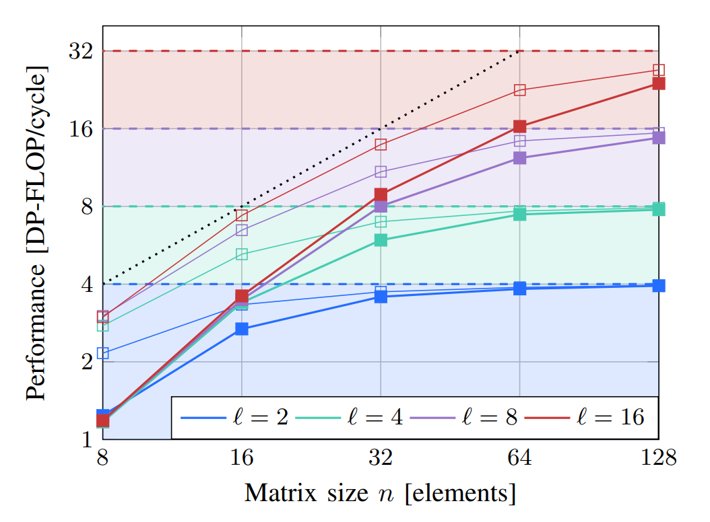
Scalar Core + Caches effect on performance
Replace CVA6 with ideal dispatcher
FIFO with V instructions
Ideal issue rate
Narrow lines on plot

Slide 156
Scalar Core + Caches effect on performance
Scalar Core + Caches effect on performance
Replace CVA6 with ideal dispatcher
FIFO with V instructions
Ideal issue rate
Narrow lines on plot
Show CVA6 + $ non-idealities

Slide 157
Scalar Core + Caches effect on performance
Replace CVA6 with ideal dispatcher
FIFO with V instructions
Ideal issue rate
Narrow lines on plot
Show CVA6 + $ non-idealities
Show VU1.0 non-idealities

Slide 158
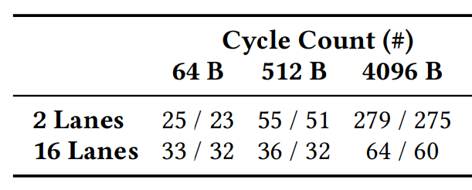
Reduction performance
dotp benchmark (chained vmul, vredsum)
Varying vector length in Byte

Slide 159
Reduction performance
dotp benchmark (chained vmul, vredsum)
Varying vector length in Byte
Performance:
26% on ideal
Performance:
94% on ideal
Longer vectors == Higher Efficiency!!

Slide 160
Reduction performance
dotp benchmark (chained vmul, vredsum)
Varying vector length in Byte
Varying vector element size: 8-bit / 64-bit
4096 8-bit Elements 512 64-bit Elements
Cycle count almost independent on element size
8-bit elements == ~8x the throughput of 64-bit elements

Slide 161
Reduction performance
dotp benchmark (chained vmul, vredsum)
Varying vector length in Byte
Varying vector element size: 8-bit / 64-bit
Varying number of lanes
High overhead by inter-lanes reduction phase
for shorter vectors or more lanes

Slide 162
Reduction performance
dotp benchmark (chained vmul, vredsum)
Varying vector length in Byte
Varying vector element size: 8-bit / 64-bit
Varying number of lanes
High overhead by inter-lanes reduction phase
for shorter vectors or more lanes

Slide 163
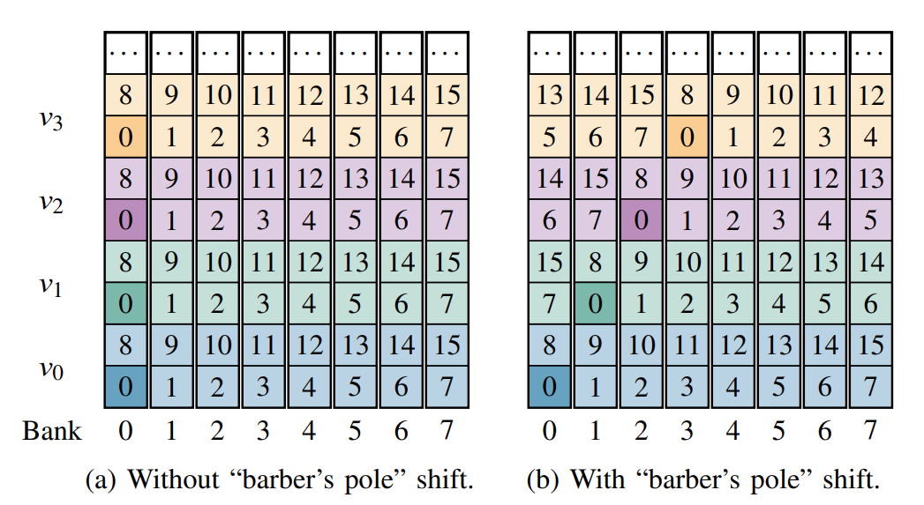
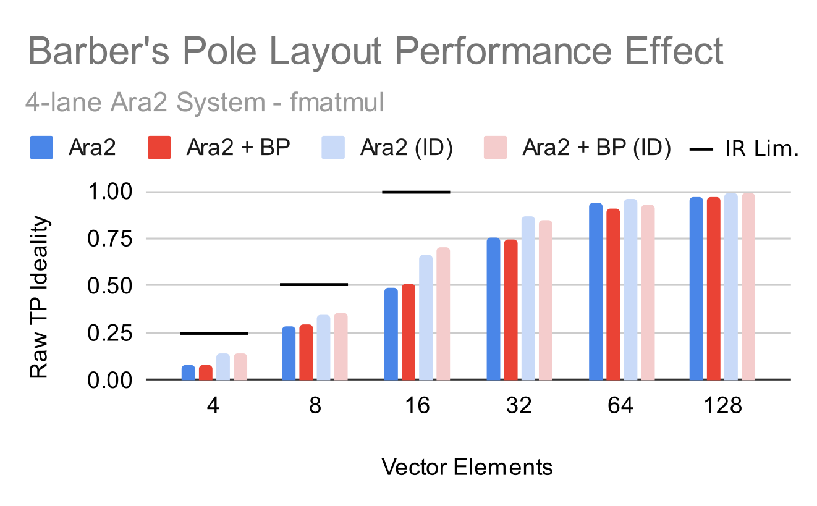
Barber's Pole layout
Ara RVV 0.5
Barber's Pole layout to speed up operand fetch
Ara RVV 1.0
No Barber's Pole
e.g., on matmul
Small positive effect on short/medium vectors
No bank conflicts upon first operands fetch
Small negative effect on medium/long vectors
More bank conflicts on different instructions
M. Cavalcante et. Al, "Ara: A 1 GHz+ Scalable and Energy-Efficient RISC-V Vector Processor with Multi-Precision Floating Point Support in 22 nm FD-SOI"

Slide 164
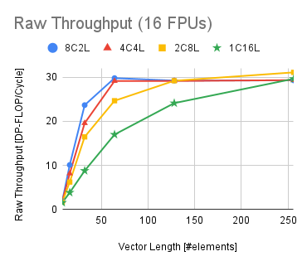
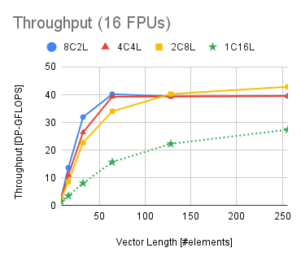
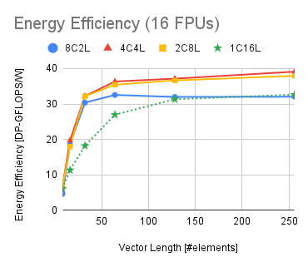
Multi-core performance, throughput, efficiency
System with 16 FPUs
Example: 8C2L = 8 (Ara+CVA6) instances

